Slide 1
UASU Health & Dental Plan
Presentation by Studentcare
Presented by Colten Yamagishi

Slide 2
Agenda
Who Are We?
What We Do
Mental Health
Plan Usage
Fee Setting

Slide 3
Who are we?
Studentcare was founded by students in 1996
Leading provider of student H&D Plans in Canada
Representing over 700,000 students at over
75+ associations
Leader in innovation, service, and technology solutions
Consultant/Broker & Administrator, accountable to the UASU

Slide 4
Plan basics
One of the largest and most popular UASU services
Established by student referendum
Over $4 million in claims paid in 2015-16
Over 20,000 students enrolled in the Plan
Integrated part of UofA landscape

Slide 5
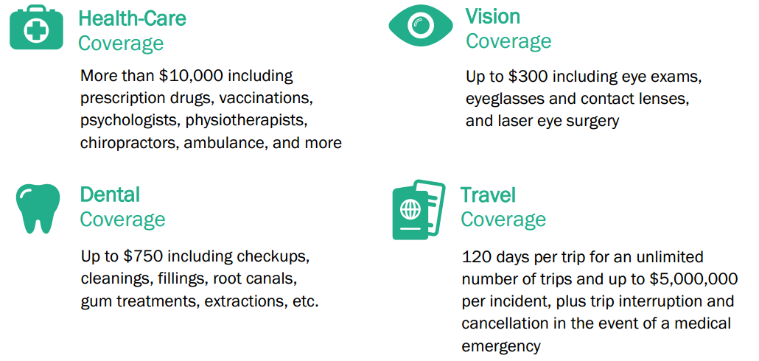
Plan benefits

Slide 6
Our Role
Consultant
Administrator
Negotiation with Insurer
Opt Out/Enrolments
Plan Set-Up
Strategy
Reporting & Surveys
Data Transfer
Communications
Community Builder

Slide 7
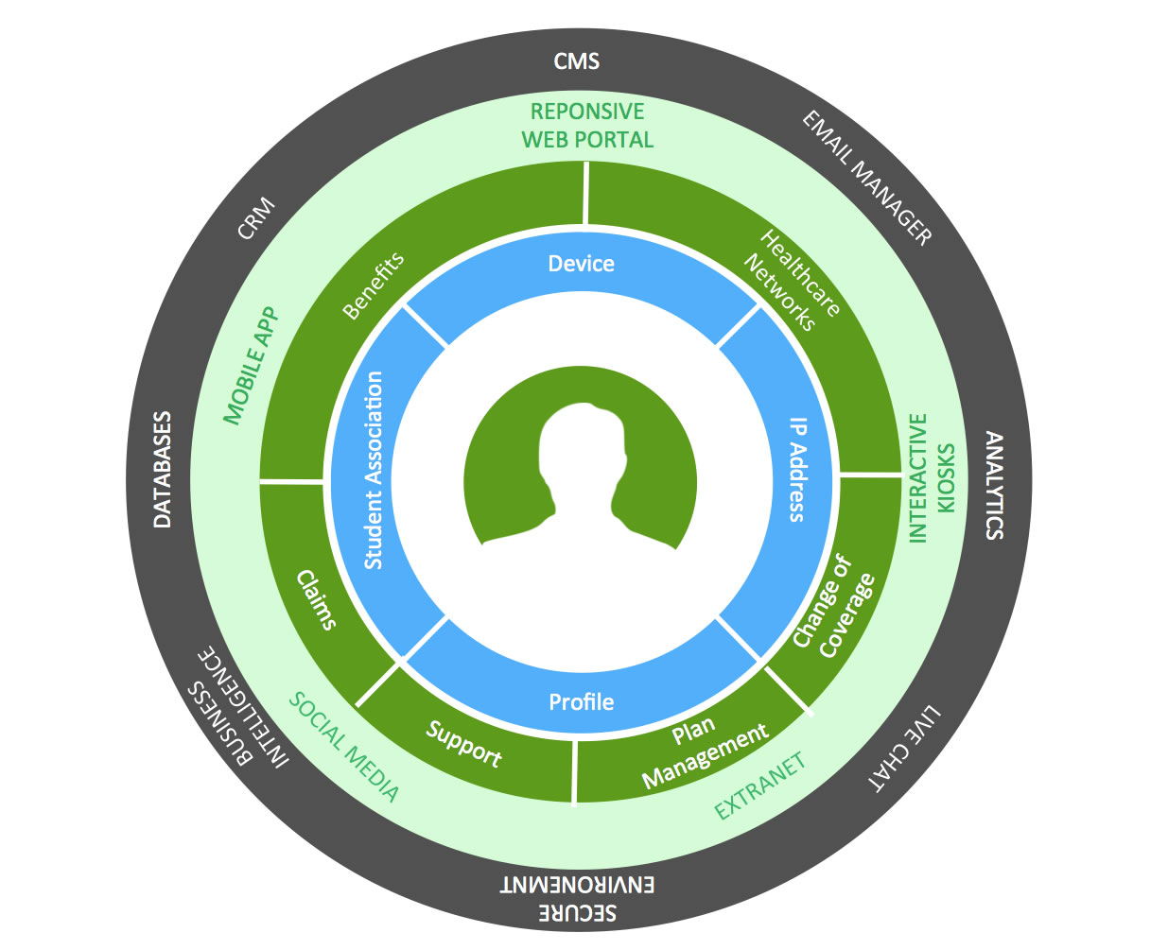
Member Services

Slide 8
Communications
Web
Targeted Email
On-Campus Events
U of A Integration
Campus Media
E-mail communications to all enrolled students
Sponsor on-campus events including WoW and the Alberta Student Leadership Summit
Advertisements in the Handbook & The Gateway
Online integration with UofA, UASU, Studentcare.ca
On-Campus Office

Slide 9
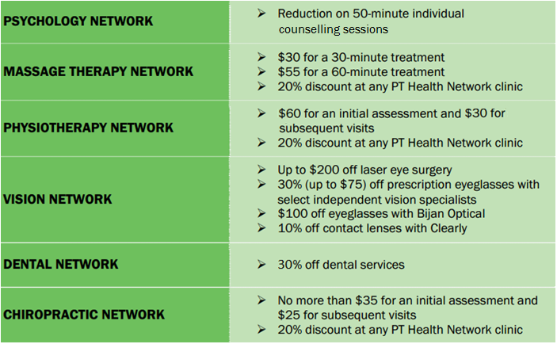
Networks

Slide 10
STUDENTCARE MENTAL HEALTH SURVEY results
Notes:
In partnership with 25 student associations across the country, Studentcare has conducted a survey in order to obtain information and feedback on students’ attitudes towards mental health and their knowledge of the resources available to them on campus and online.
The report has been prepared by Studentcare’s research staff and is based on survey data collected by email from March 22 – April 22, 2016. The survey provided students with an opportunity to comment on a number of key issues, including attitudes towards mental health and illness, resources available online and on campus, social distance, and personal experience with mental illness.

Slide 11
UASU vs. National Average
Mental Health was considered “very important” to 77.7% of respondents (national 77%)
54.7% of students surveyed have personally experienced a mental illness. 43.8% have been treated negatively because of it (national 44.5%).
87.7% of students are aware of the existence of mental health services on campus (national 79%). 28.8% have used them (national 40.7%)
Notes:
The objective was to obtain at least 300 responses. Overall, 455 surveys were completed.
- 97.2% of respondents either agree or strongly agree that our society needs to reduce prejudice and discrimination against people experiencing a mental illness. - 82.0% of respondents said they were not aware of other mental health initiatives or events taking place on campus (apart from the campus’s mental health services such as counselling and peer support groups).

Slide 12
Plan Usage

Slide 13
Health Claims Breakdown
Notes:
We negotiate on your behalf

Slide 14
Dental Claims Breakdown
Notes:
We negotiate on your behalf

Slide 15
Per Capita Health Claims
12%
Increase
Psychology Benefit Increases
Provider Change to Desjardins
Notes:
We negotiate on your behalf

Slide 16
Per Capita Dental Claims
15%
Increase
Dental Benefit Decreases
On Campus Dental Clinic Opens
Provider Change to Desjardins

Slide 17
Highlights
Health Claims
Dental Claims
Huge increase in non-preventative procedure claims (32.5% per capita increase in claims paid)
Significant increases in Vision Care, Physio/Chiro, & P. Drugs
117% per capita increase in Psychology Claims paid

Slide 18
Fee Setting

Slide 19
Fee Setting: Factors
Plan Fee is set by UASU Council = Steady
Plan Premiums are driven by Claims = Fluctuate
UASU Reserve Fund in place to balance fluctuations

Slide 20
Fee Setting: Options
A. Increase Plan Fee
B. Subsidize Fee Using Reserve Fund
C. Reduce Benefits
Requires approval of Council

Slide 21
Fee Setting
PLAN FEE OPTIONS FOR DISCUSSION | Health | Dental | Total
Projected Total Plan Cost (2017-2018) | $138.54 | $155.37 | $293.91
Current Plan Fee (2016-2017) | $129.80 | $128.15 | $257.95
Difference between Projected Plan Cost & Current Fee | $8.74 | $27.22 | $35.96
% Difference | 7% | 21% | 14%
Plan Fees with 10% OVERALL increase , Reduce Dental Annual Max from $750 to $650, + Rebalancing | $136.50 | $147.20 | $283.70
Per Member Amount Required from SU Reserve Fund | $2.26 | $1.91 | $4.18
Projected Total Reserve Subsidy (using current enrolment) | $47,199 | $39,715 | $86,914
Percentage of 2016-17 Plan Cost subsidized from Reserve |  |  | 1.5%

Slide 22
HDPC Recommendation
Increase Plan Fee
B. Subsidize Fee Using Reserve Fund
C. Reduce Benefits
10% increase
Contribute approx. $80-$90K from Reserve (approx. 10% of Fund)
Reduce Dental Annual Maximum from $750 to $650
D. Rebalance Health & Dental Fees
To better reflect projected premiums for each individual Plan
Notes:
How do we find 14%?
10% Fee Increase + 1.5% from Reserve Fund + 2.5% from Benefit Reduction = 14%
Rebalance just makes the fees more closely resemble the premiums

Slide 23
Questions?
Questions?
Questions / Discussion

