Slide 1
Campus Food Bank
Cory Rianson
Executive Director
ed@campusfoodbank.com

Slide 2
Campus Food Bank History
Created in response to increases in international student tuition in 1991
Students from all backgrounds began accessing the service, not just anticipated group
Moved from being a small service to a independent non-profit organization
Supported by the campus community and alumni
Notes:
A little bit about us, to get started.

Slide 3
What is Food Security?
Food security exists when all people, at all times, have physical, social and economic access to sufficient, safe and nutritious food which meets their dietary needs and food preferences for an active and healthy life.
FAO. 2002. The State of Food Insecurity in the World 2001. Rome.
Notes:
The absence of any or multiple of these requirements would make a person food insecure, either on a short term, longer term or chronic basis.

Slide 4
Food Insecurity on Canadian Campuses
39% of students moderately or severely food insecure across 5 Canadian campuses (including U of C)
Silverthorn, D. (2016). Hungry for knowledge: Assessing the prevalence of student food insecurity on five Canadian campuses. Toronto: Meal Exchange. Retrieved from: http://mealexchange.com
35% of students moderately or severely food insecure at University of Manitoba
Entz, Slater, & Desmarais (2017). Student food insecurity at the University of Manitoba. Canadian Food Studies, Vol. 4 No. 1, pp. 139–159 DOI: 10.15353/cfs-rcea.v4i1.204
40% of students experience some degree of food insecure at University of Saskatchewan
Caitlin Olauson, Rachel Engler-Stringer, Hassan Vatanparast & Rita Hanoski (2018) Student food insecurity: Examining barriers to higher education at the University of Saskatchewan, Journal of Hunger & Environmental Nutrition, 13:1, 19-27, DOI: 10.1080/19320248.2017.1393365
Notes:
Research shows similar rates all across North America

Slide 5
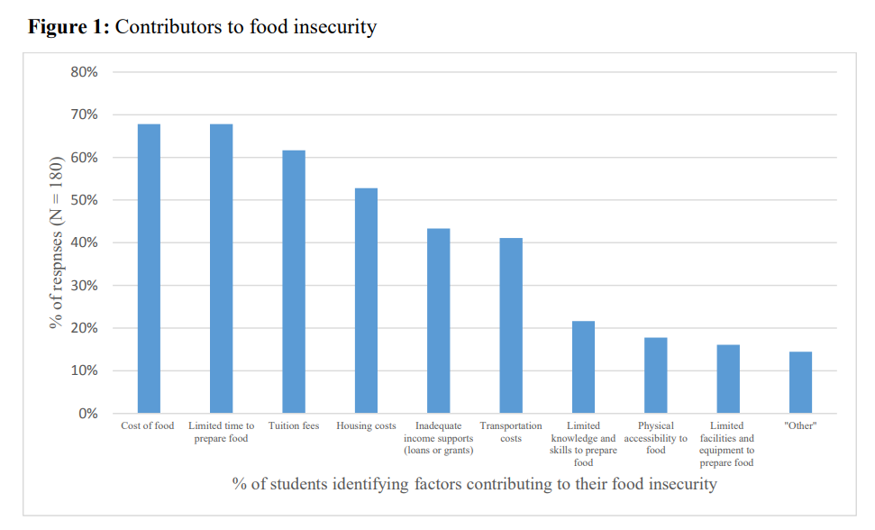
Education Costs and Barriers
Entz, Slater, & Desmarais (2017). Student food insecurity at the University of Manitoba. Canadian Food Studies, Vol. 4 No. 1, pp. 139–159 DOI: 10.15353/cfs-rcea.v4i1.204
Notes:
Why are food insecurity rates higher?
Tuition, school fees, textbooks and other academic costs
Time to prepare food that’s cheap and nutritious
Knowledge on cooking, nutrition, and shopping

Slide 6
Stereotypes of Students
Students are often assumed to be:
  18-24 year olds
  Supported by parents or family
  Certain amount of privilege
  International students are wealthy
Stereotype of how students should live (ex Eating instant noodles and Kraft Dinner)
  “Starving student”-adversity is just part of the experience of being a student

Slide 7
At Increased Risk of Food Insecurity
International students have 2 times the increased risk compared to domestic students
Graduate students have 1.2 times the increased risk
Students who parent have 1.7 times the increased risk
*Based on Odds Ratio (OR) where greater than 1 indicates an increased association with being food insecure.
Caitlin Olauson, Rachel Engler-Stringer, Hassan Vatanparast & Rita Hanoski (2018) Student food insecurity: Examining barriers to higher education at the University of Saskatchewan, Journal of Hunger & Environmental Nutrition, 13:1, 19-27, DOI: 10.1080/19320248.2017.1393365

Slide 8
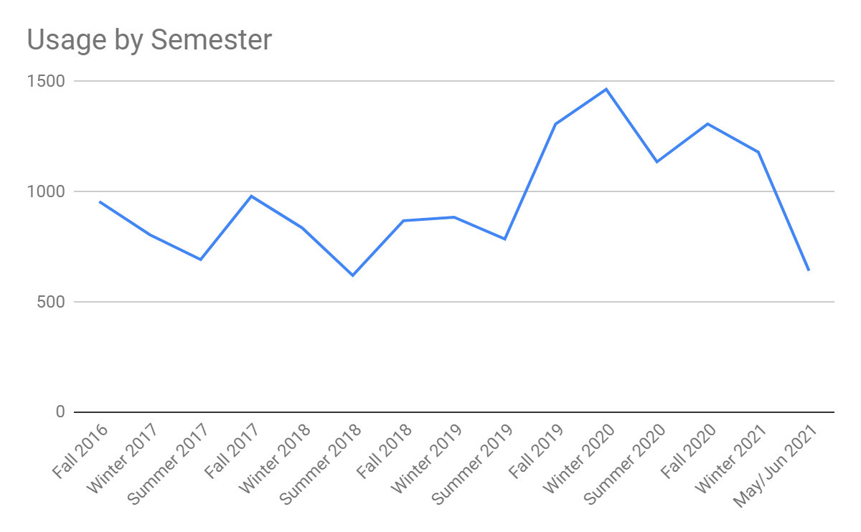

Slide 9
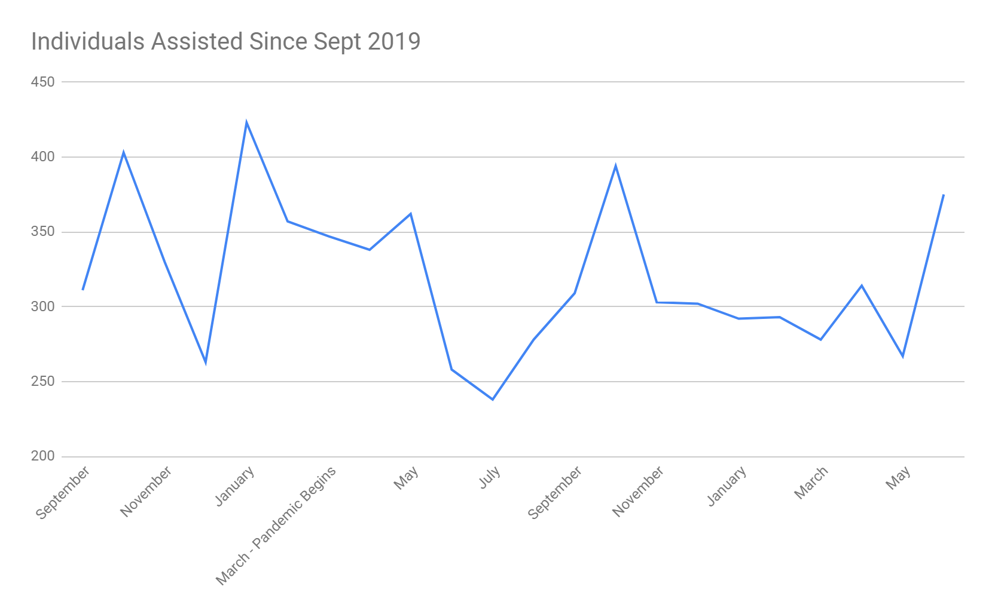

Slide 10
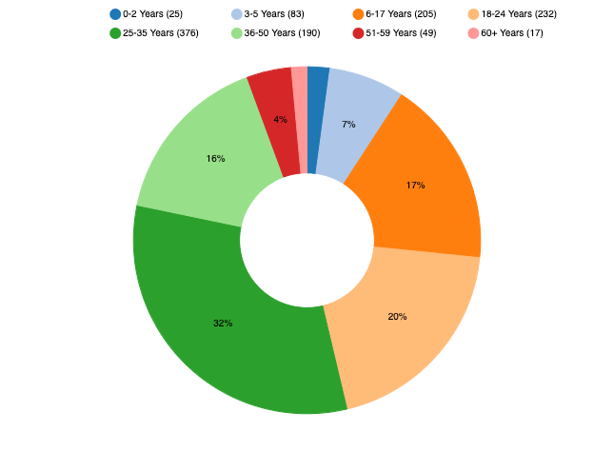
Who the CFB helps: Age of Individuals Assisted in Winter 2021

Slide 11
Student Status Winter 2021
 | % of Total Usage |  | % of Total Usage
Undergraduate Students | 36% | Arts | 7%
Graduate Students | 56% | Education | 7%
International Students | 66% | Nursing | 7%
Domestic Students | 27% | Medicine & Dentistry | 4%
Engineering | 23% | Open Studies | 3%
Sciences | 20% | Native Studies | 2%
ALES | 13% | Business | 2%

Slide 12
I am in school full-time and my spouse takes care of our three kids. My part-time income from my program doesn’t cover our living costs, so we rely on the Child Tax Benefit and occasional food hampers to cover gaps.
I am taking care of my grandkids while back in school. My program funding has been delayed, so the food bank helps me feed my family.
The currency rate has dropped back home so my family is no longer able to help when my savings are running low.
I am new to Alberta and I have difficulty finding low cost food options that fit my dietary restrictions. I am not used to the food options here yet.
My student loans were delayed, and I have bills such as rent and tuition that have to be paid on time. Paying for food too is tough right now, so using the food bank is helping me afford it.
Notes:
What brings people to our food bank (variety of reasons and circumstances) *Paraphrased, as shared with CFB staff. All stories are shared without descriptors, to maintain anonymity and confidentiality. Mixture of Student Specific Stories, International Student Specific, and Stories Relatable to other food banks

Slide 13
What is the Campus Food Bank Doing About Food Insecurity in Our Community?

Slide 14
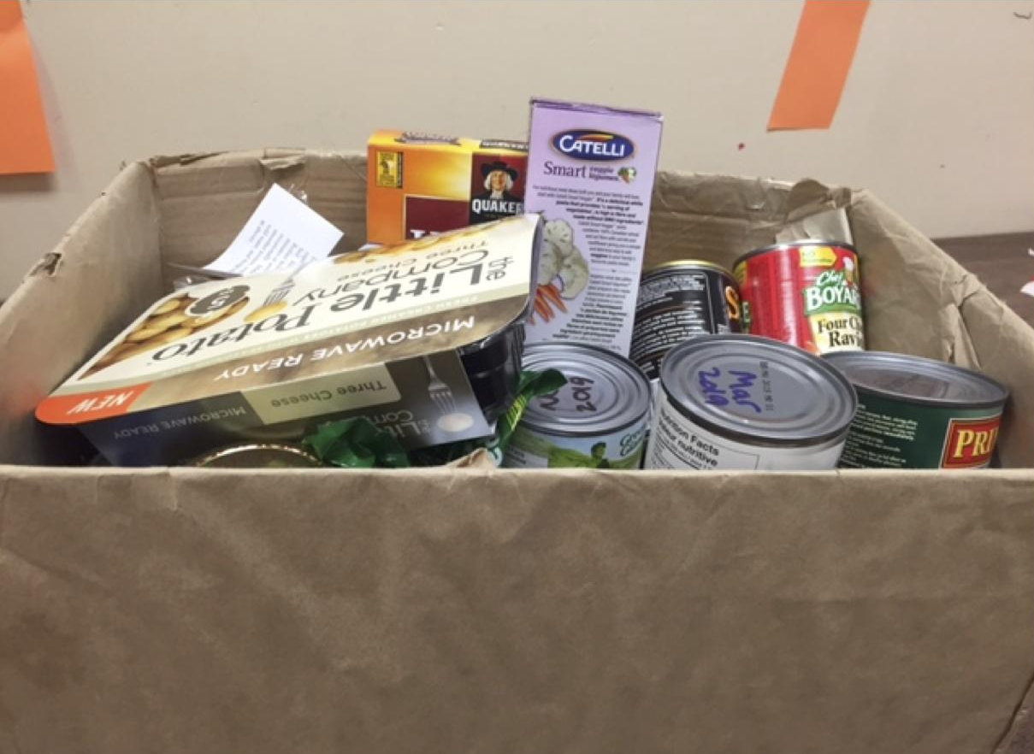
Hamper Program
Non-perishables and perishables, available biweekly
Prioritize dietary restrictions and allergies
Supplementary, to cover basic items
2300 hampers last academic year
Received grant to purchase perishable items

Slide 15
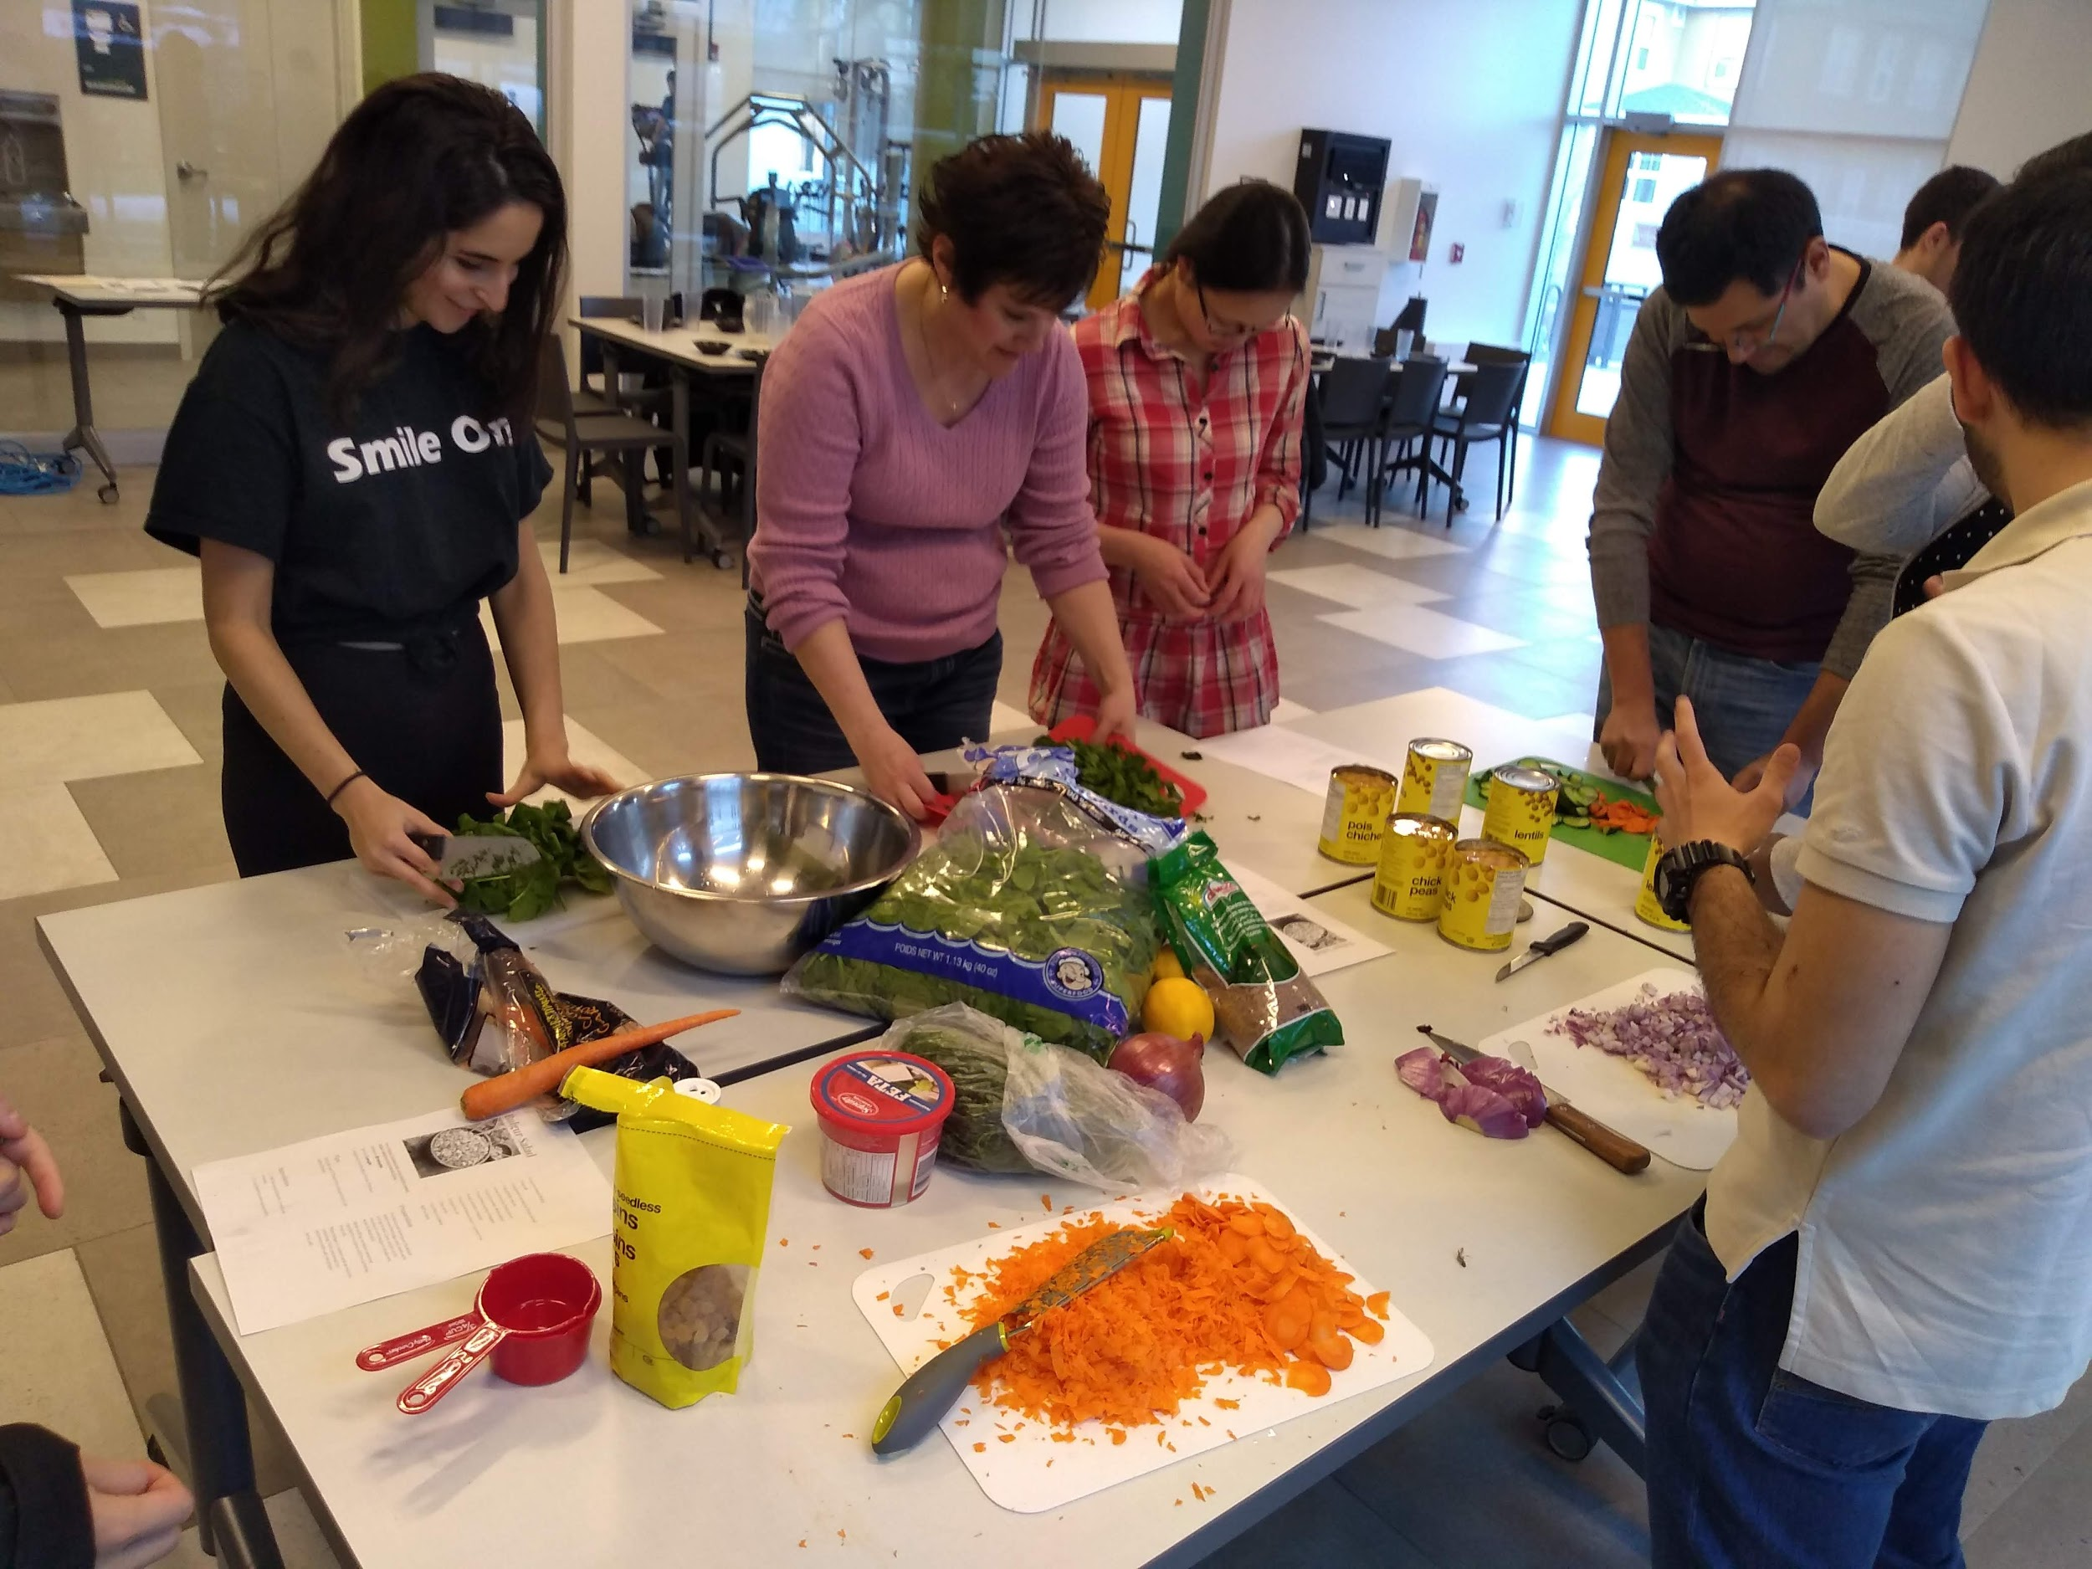
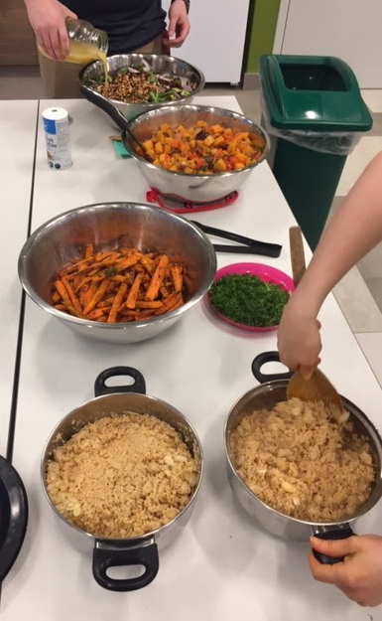
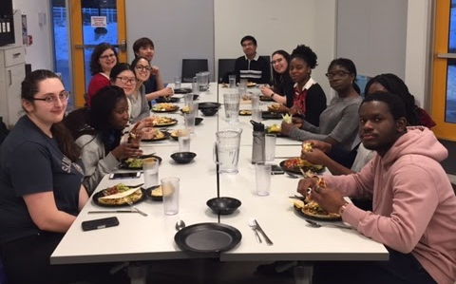
Campus Kitchens
Addressing lack of time to cook, as well as any food knowledge gaps
Community building, a free meal and basic cooking skills and recipes
Non-judgemental setting, to learn skills and talk more around food

Slide 16

Grocery Buses
Provide access to lower cost grocery options, with a broad selection of foods
Address gaps in available food near campus, such as halal meats, bulk food items, lower cost generally

Slide 17
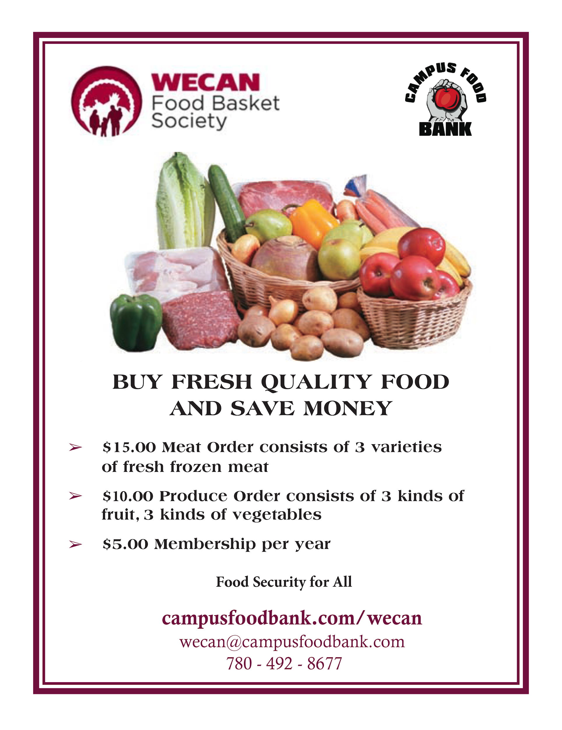
WECAN Food Basket
Edmonton-based non-profit
Low cost grocery option
Bulk-purchasing model (not subsidized by the food bank)
A way to shop smart and conveniently
Introduction to the food bank
Added Halal option this year

Slide 18
Upcoming Events
Trick or TrEAT Food Drive - October 30th
Door to door food drive with neighbourhoods surrounding University
Sign up to volunteer individually or in a team
Costumes encouraged!
Fast and Studious - November 8th to 25th
Peer to Peer fundraiser
Collect donations from friends a family in support of CFB and U of A Safehouse Program
Fast for 24 hours to raise awareness of hunger
All donations matched by EPCOR

Slide 19

Contact Information
Cory Rianson
ed@campusfoodbank.com
Our Website:
campusfoodbank.com

