Slide 1
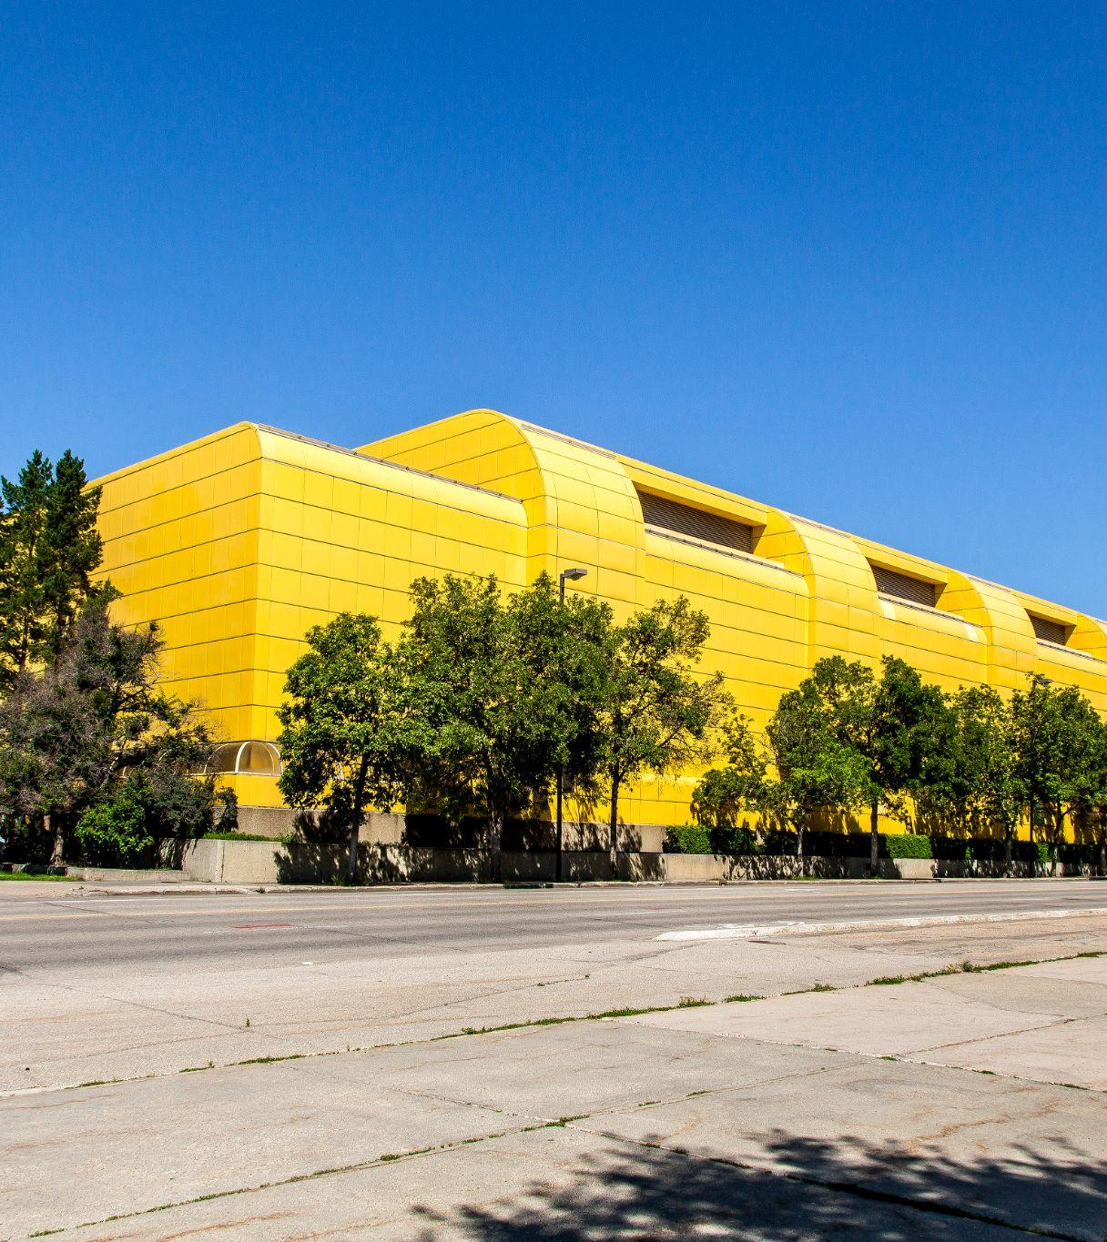
Athletics & Recreation Fee
Golden Bears and Pandas Athletics
Campus & Community Recreation

Slide 2
What is Athletics & Recreation Fee?
Athletics & Recreation Fee
This fee is one source of revenue supporting sport, recreation, leisure, and physical activity services, including:
the management, operation, and maintenance of sport and recreation facilities and training spaces;
the management of physical activity and wellness programs in the areas of group fitness, intramural sports, dance, recreational, sport and leisure activities, and sport clubs;
the administrative and coaching support requirements for Golden Bears and Pandas Athletics.
For more information about specific programs and activities: uab.ca/recreation or uab.ca/athletics

Slide 3
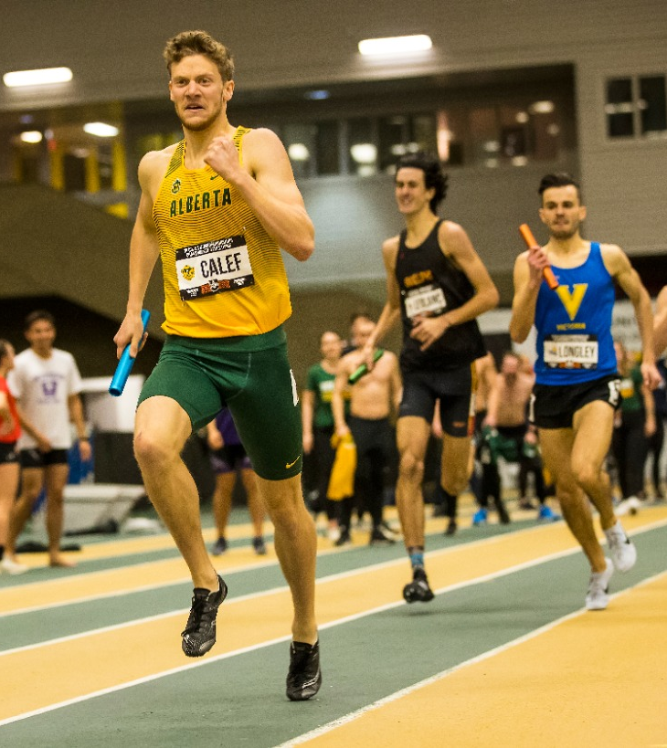
Principles
Transparency
Accountability
Partnership
Collaboration
Consultation

Slide 4
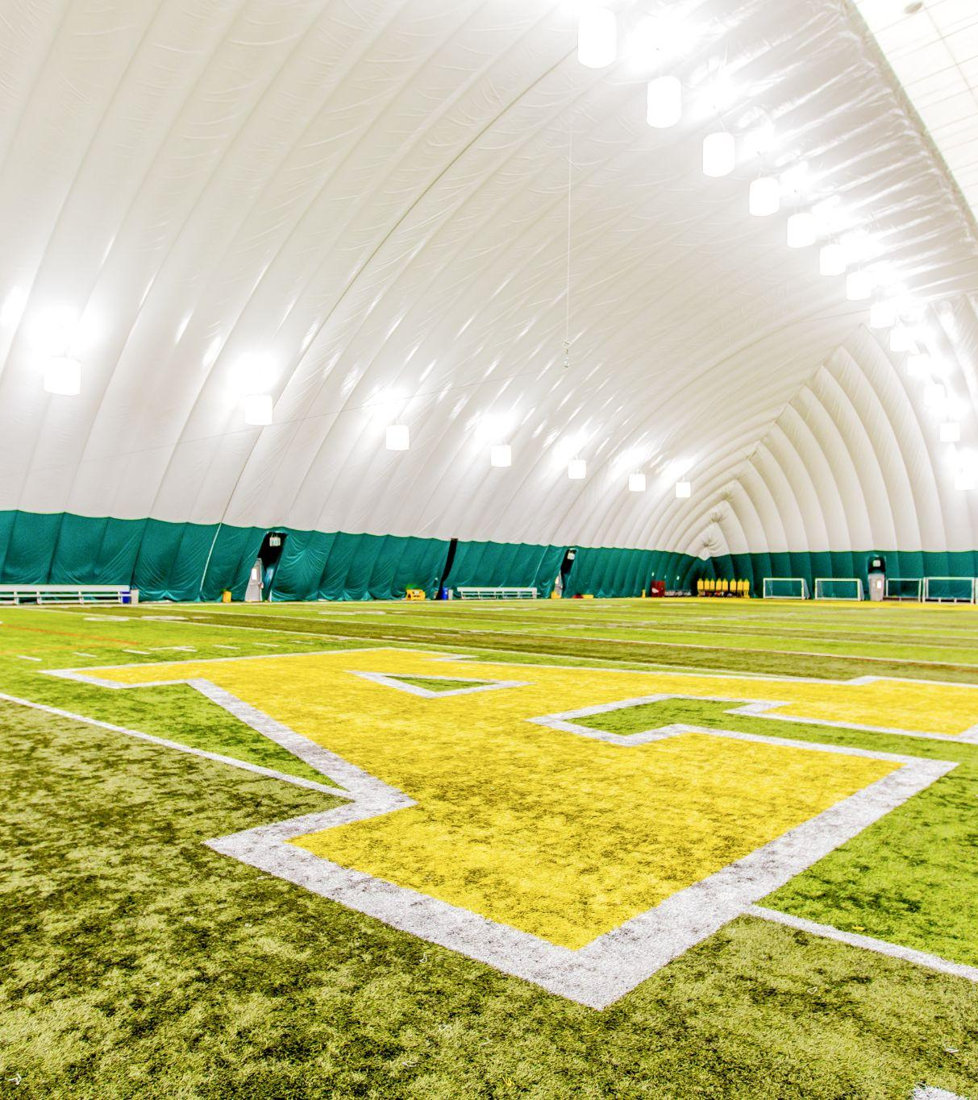
Transparency
Students pay approximately $5.8 million in A&R Fees
Students want to know what their fees pay for
Athletic & Recreation fees pay part of the cost to provide sport and recreation services to students

Slide 5
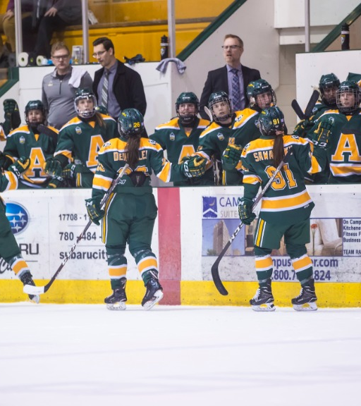
Accountability
A&R Fee is part of the MNIF, therefore overseen by the MNIF Oversight Committee
Allocation of the funds and oversight of the provision of services is the responsibility of:
Dean of Students - delegates to Ian Reade, Director of Athletics
VP Facilities and Operations - delegates to Cheryl Harwardt, Director of Campus & Community Recreation

Slide 6
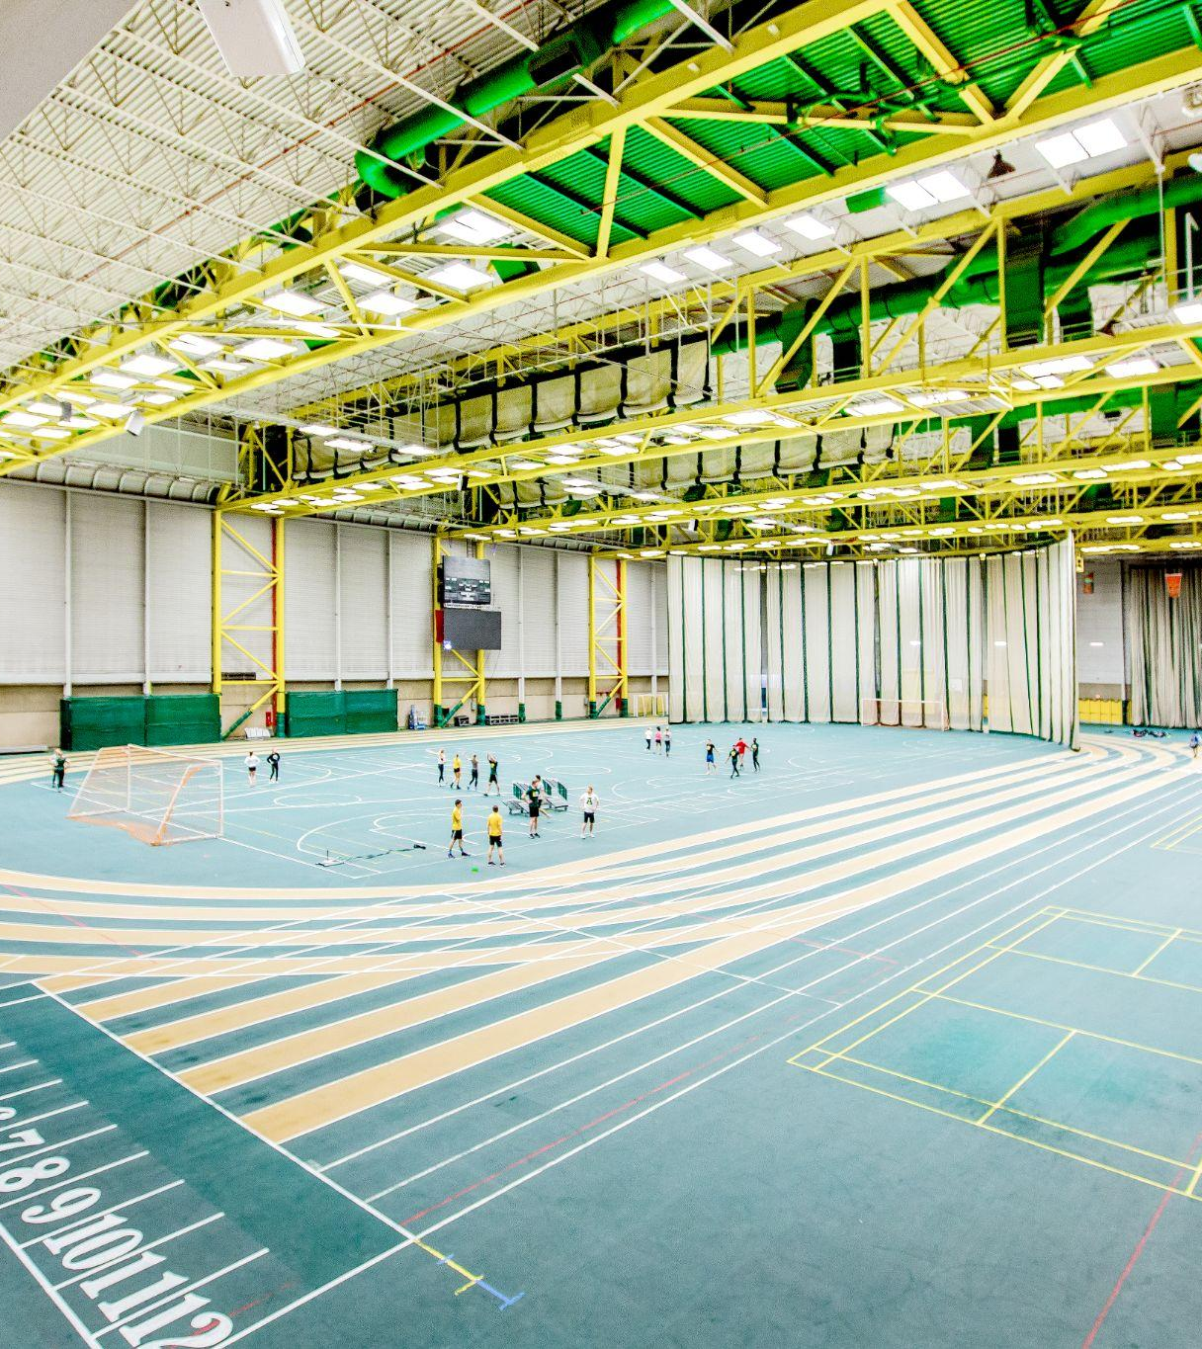
Collaboration and Consultation
Bi-annual report to SU/GSA
MNIF Oversight Committee
Regular meetings with SU and GSA VP Student Life
Recreation Action Committee

Slide 7
Campus & Community Recreation
Who We Are
Vision: Inspiring and empowering exceptional life experiences through recreation, sport and wellness
Mission: Facilitate and deliver leading-edge programs, events, services and facilities for our communities
Values: Leadership - Collaboration - Kaizen - Civility - Inclusiveness

Slide 8
Campus & Community Recreation
Services
Management of Facilities - Arena, Climbing Centre, Fitness Centre, Gymnasiums, Studios, Activity spaces, Pavilion, Squash Courts, Swimming Pools
Programs/Events - Club Sports, Intramurals, Group Exercise, Instructional Recreation classes, Residence programming, Wellness Initiatives
Events - Big Pink, Pond Hockey, RecStock
Employment Opportunities

Slide 9
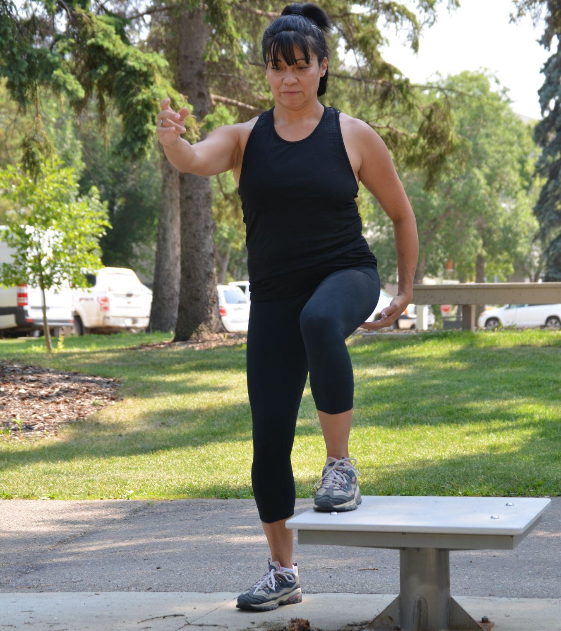
Campus & Community Recreation
Funding Partnerships
Major Sources of Revenue:
U of A Operating Contribution - $1.5 million
Revenue raised - $3.3 million
Total non-fee revenue - $4.8 million
Athletic & Recreation Fee - $2.06 million
Wellness funds - $140,000
Total CCR Revenue - $7 million
NOTE: (UA also provides utilities, cleaning and facility envelope maintenance)

Slide 10
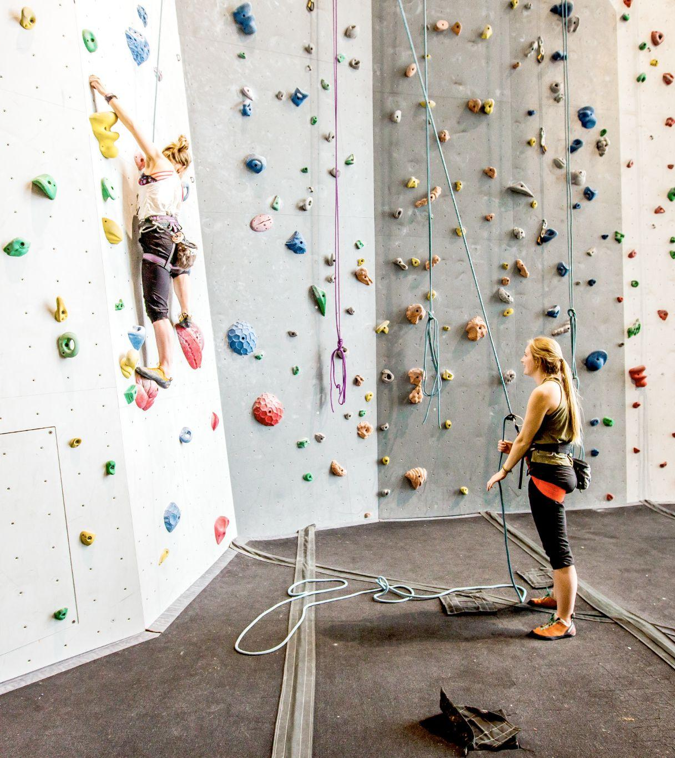
Campus & Community Recreation
Major Expense
Facility staff wages/benefits - $4.6 million
Student staff wages - $650,000
Operating costs - $2.6 million
Capital Replacement/Repair - $200,000
Total Expenditures CCR - $8 million
NOTE: (includes wellness)
NOTE: Net Deficit in 2020-21 = $1 million

Slide 11
Campus & Community Recreation - Key Stats
 | 2020-21 | 2019-20 | 2018-19 | 2017-18 | 2016-17
Fitness Centre | 91,163 | 342,641 | 506,372 | 544,877 | 641,715
Climbing Centre | 1,272 | 6,660 | 13,572 | 19,893 | 22,255
Locker Rooms | 155,204 | 701,320 | 330,535 | 1,275,192 | 1,022,640
Your source information here.

Slide 12
Golden Bears and Pandas Athletics
Manage 24 Golden Bears and Pandas varsity teams for 500 student athletes competing annually for national championships.
- Recruit 100+ student athletes per year across all Faculties.
- Host 100+ events per year for students and community.
- Provide mental health support for student athletes.
- Engage with the community through sport development programs for 3000+ youth.
- Raise $1.6M to provide financial assistance to student athletes.
- Engage with 6500+ U of A Athletics Alumni.
- Community outreach to schools, hospitals and charities

Slide 13
Golden Bears and Pandas Athletics
Important Metrics:
- Student athlete recruitment, retention and support
- Revenue generated to support the programs
- Alumni support and engagement metrics
- Amount of donations received
- Amount of scholarships provided
- Access to mental health support for varsity athletes
- Student and student athlete feedback
- Contributions to teaching and research
- Community outreach by student athletes through UAB
- Community partnerships
- Developmental athlete programming
- Normally, competitive results are an important metric

Slide 14
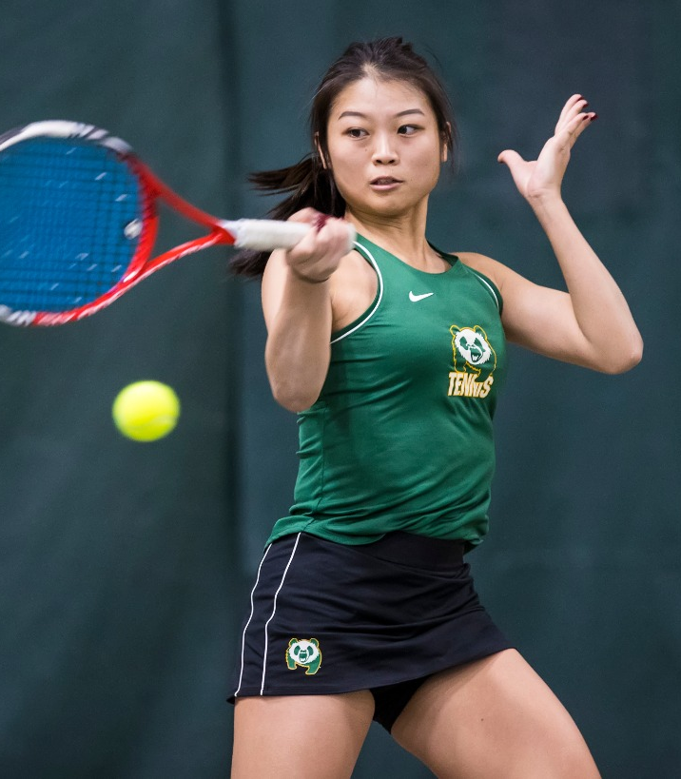
Golden Bears and Pandas Athletics
Rounded totals; not a normal operating year
Funding Partnerships
Major Sources of Revenue
U of A Operating $ 2,000,000
Donations and grants $ 1,000,000
Sponsors $ 300,000
Alumni $ 2,000,000
Community Programs $ 200,000
A&R Fee to Athletics $ 3,000,000
Total Revenue Athletics $ 8,500,000

Slide 15
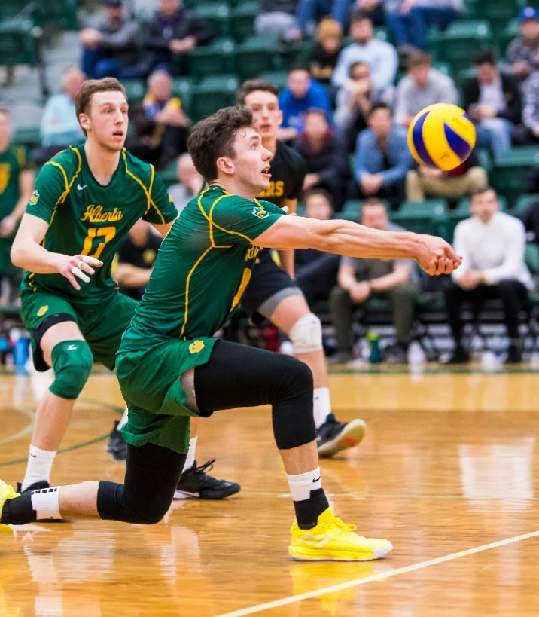
Golden Bears and Pandas Athletics
Major Expenditures
Salaries and benefits $ 5,000,000
Travel $ 1,500,000
Supplies and services $ 1,500,000
Rentals $ 500,000
Total Expenditure Athletics $ 8,500,000
Student Scholarships (in addition) $ 1,200,000

Slide 16
Campus & Community
Recreation
uab.ca/recreation
Golden Bears and Pandas
On the Road
Canadawest.tv

