Slide 1
Education Students’ Association FAMF Proposal
Prepared by:
Edward Tiet (Vice-President Finance)
esafin@ualberta.ca
Rowan Morris (Vice President External)
esaext@ualberta.ca

Slide 2

Purpose of the Fee
Provide membership in the ATA
Student local membership is needed for
  ATA library
  Membership in ATA specialist councils
  Attend Teachers convention
    A requirement for fourth year students
Notes:
Edward
The purpose of the fee is to provide all Education students with membership in the Alberta Teachers’ Association (ATA) Student Local No 1 and to support the ESA in providing services and events to Education students for free or at the lowest cost possible. Students need to join their university’s student local in order to become student members of the ATA, and with the continuation of FAMF all students would automatically be members of their ATA student local with access to membership benefits like the ATA library, membership in ATA specialist councils, and the ability to attend teacher’s convention (a requirement for many fourth-year students). The ESA hosts a variety of social, and professional development events to enhance the undergraduate experience of its members and prepare them for their teaching careers. Hundreds of students attend these events, and it is extremely important that they go to them.
Continuing to collect a FAMF will enable us to offer enhanced services and events to students at low or no cost. Additionally, continuing to have a FAMF will mean that ESA Council can spend their time more efficiently on organizing services for students. Before collecting a FAMF, a disproportionate amount of time was spent simply collecting membership fees.

Slide 3

Purpose of the Fee
ESA Programming
  Professional Development Sessions
  Social events
  Mentorship programs
  Volunteer opportunities
  Graduation celebrations
Create scholarships
Notes:
Rowan
to support the ESA in providing services and events to Education students for free or at the lowest cost possible. The ESA hosts a variety of social, and professional development events to enhance the undergraduate experience of its members and prepare them for their teaching careers. Hundreds of students attend these events, and it is extremely important that they go to them.
Continuing to collect a FAMF will enable us to offer enhanced services and events to students at low or no cost. Additionally, continuing to have a FAMF will mean that ESA Council can spend their time more efficiently on organizing services for students. Before collecting a FAMF, a disproportionate amount of time was spent simply collecting membership fees.

Slide 4
The amount of the fee, who pays and how often?
$8 per year
Revisited in 3 years
Full time and part time students will pay the same
Notes:
Edward
The proposed FAMF is $8 per year for 3 years consecutive until August 31, 2025 and would be collected from both full-time and part-time students in the fall semester. Of this fee, $1 would be forwarded to the Alberta Teachers’ Association as payment for membership in the student local, and the rest would be used to provide improved services and events to students at the lowest cost possible. Even though tuition is rising, we are keeping the $8 FAMF fee the same from our last FAMF duration from 2018-2021 to help the students save as much financial costs as possible, but providing the same services.

Slide 5
The Scope of the Membership Fee
This fee would be collected from all 3800 undergraduate Education students who are eligible to be members of ATA student local #1
all full- and part-time undergraduate students at the University of Alberta
Notes:
Rowan
This fee would be collected from all undergraduate Education students who are eligible to be members of ATA student local #1 (all full- and part-time undergraduate students at the University of Alberta). Students in the off-campus collaborative programs at Red Deer College, Keyano College, and Grande Prairie Regional College belong to different student locals and would not be eligible for this fee or membership in the University of Alberta ESA.

Slide 6
When will the fee begin?
September 1 2022 until August 31 2025
Notes:
Edward
The fee would be collected every year with tuition fees, beginning September 1, 2022, for a term of three years, ending in August 31, 2025.

Slide 7
Refund mechanism of the fee
Those who are philosophically opposed or unable to pay the fee shall be reimbursed the full amount of the fee.
Students will have until October 31st to fill out a reimbursement form at the ESA office, and afterwards will be able to collect a cheque for the full amount of the fee.
For international students and students who can not accept a cheque as a refund, they will get reimbursed through cash.
Notes:
Rowan

Slide 8
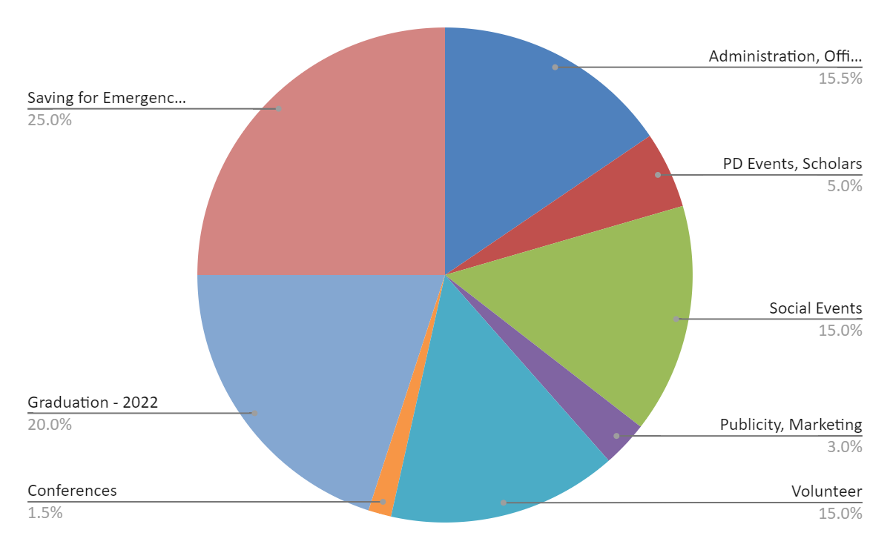
Allocation of the fee
Predicted Budget: $31,200
$4836.00
$7,800
$1560.00
$4680.00
$6,240
$936.00
$468.00
$4680.00
Notes:
Edward
The allocation of the fee will be going towards student services within our office space, free snacks for education students, social events that are going to be free/low cost for students and for our new awards that we are establishing for 2022. We will be taking $1.00 from the $8.00 as membership to be given for the ATA. The FAMF membership will get pooled with our current funding and grants from the Alberta Teachers’ Association, and this is our budget for this year (2021-2022).
The 15.5% going into Administration, Office Upkeep, Meetings, Elections, Merchandise, Website will be used for buying our Education merchandise since we usually buy in bulk, paying for our website domain (esaualberta.ca), as well as office supplies like paper for printing and used in for volunteers.
The 5.0% going into PD Events, and Scholars, will be going into finding new professional development speakers, as well as gifts for our speakers who come and talk to us during our Education Week (weeklong PDs in January)
The 15.5% going into Social Events will be predominantly used for hosting events as well as prizes for the winners of our events, and this will also be including our large annual event (Frosty Fest), where it will be a fun night where students will get together and have fun.
As you can see, on the graph on the left, this is our current budget and where the money is being allocated to for certain areas within the ESA. We do try to keep money for emergencies, since we need to make sure that we are at a surplus for the ATA, as well as so we can keep on the safe sides of things. We are running straight from our bank account this year, with exception of the ATA grant, and that is how much I have budgeted for this year.

Slide 9
Allocation of the fee
Predicted Budget: $31,200
$4836.00
$7,800
$1560.00
$4680.00
$6,240
$936.00
$468.00
$4680.00
Notes:
Edward
The allocation of the fee will be going towards student services within our office space, free snacks for education students, social events that are going to be free/low cost for students and for our new awards that we are establishing for 2022. We will be taking $1.00 from the $8.00 as membership to be given for the ATA. The FAMF membership will get pooled with our current funding and grants from the Alberta Teachers’ Association, and this is our budget for this year (2021-2022).
The 15.5% going into Administration, Office Upkeep, Meetings, Elections, Merchandise, Website will be used for buying our Education merchandise since we usually buy in bulk, paying for our website domain (esaualberta.ca), as well as office supplies like paper for printing and used in for volunteers.
The 5.0% going into PD Events, and Scholars, will be going into finding new professional development speakers, as well as gifts for our speakers who come and talk to us during our Education Week (weeklong PDs in January)
The 15.5% going into Social Events will be predominantly used for hosting events as well as prizes for the winners of our events, and this will also be including our large annual event (Frosty Fest), where it will be a fun night where students will get together and have fun.
As you can see, on the graph on the left, this is our current budget and where the money is being allocated to for certain areas within the ESA. We do try to keep money for emergencies, since we need to make sure that we are at a surplus for the ATA, as well as so we can keep on the safe sides of things. We are running straight from our bank account this year, with exception of the ATA grant, and that is how much I have budgeted for this year.

Slide 10
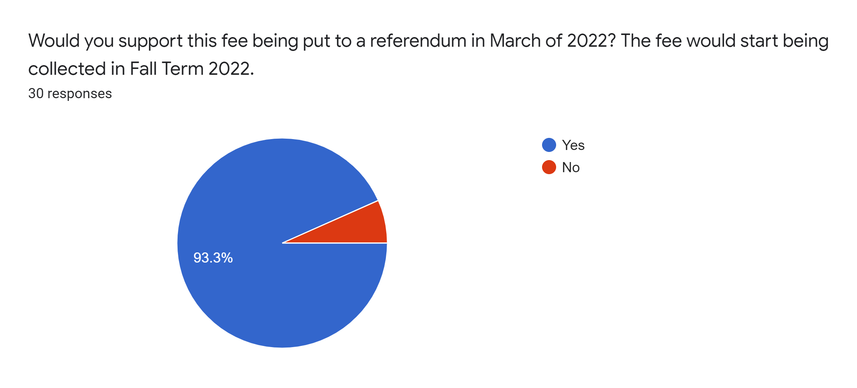
Consultation of Students
During a consultation with Education students, we have made the survey available to all students and have had 30 respondents at this point
the majority of these students support the idea of having our FAMF being put into referendum in March 2022. We are still waiting for a large listserv email out to all undergraduate students in the faculty for their responses.
Notes:
Rowan
We are still waiting for a large listserv email out to all undergraduate students in the faculty for their responses.

Slide 11
Financial oversight of the fee
The fee will be overseen as per the ESA Finances Policy Document and ESA Constitution as they are currently written, in accordance with SU Bylaw 8200. This includes ongoing financial reporting by the ESA VP Finance and a yearly independent audit; the Finance Policy also requires a statement of the audit be submitted to ESA Council, the ATA and the Student Governance Advisor for full oversight and transparency. Additional oversight measures can be found in the ESA Finances Policy.
Notes:
Edward

Slide 12
The Goal of this Fee is to better the lives of education students
Notes:
The services provided by the ESA are completely selfless. The true goal is to have our students leaving stronger than before. Our snack program is a method of combatting food insecurity. Our volunteer opportunities double as networking. Our partnership with the ATA sets students up for success in the workforce. Our professional development sessions are cutting edge and presenting students with the most updated and accurate information for their careers . Just last night we were able to present western canada’s first ever professional development session dedicated specifically to creating inclusive and safer classroom environments for trans students. The bottom line of this famf is benefit education students. Tuition is rising but we are coming to you now only asking for what we need. We are committed to providing education students with a university experience as barrier free as possible and our famf can make that happen.

Slide 13
Conclusion
The mandate of the Education Students’ Association is to create a community for all students within the Faculty of Education, provide leadership and a voice for all Education students, and perform valued services including opportunities for student involvement. With the continuation of FAMF, we will continue to be well-equipped to perform the services and events that help us create community in the Faculty. We would also be able to continue to focus our time on activities that directly serve students, like event-planning and advocacy work, as opposed to selling and distributing memberships.
The ESA hopes you will approve our proposal for FAMF as it would allow us to better serve our mandate of helping Education students.

Slide 14
Questions?

Slide 15
Thank you!

