Slide 1


An Overview of the
Council of Alberta University Students
Dexter Bruneau, Chair
Josh McKeown, Interim Executive Director

Slide 2
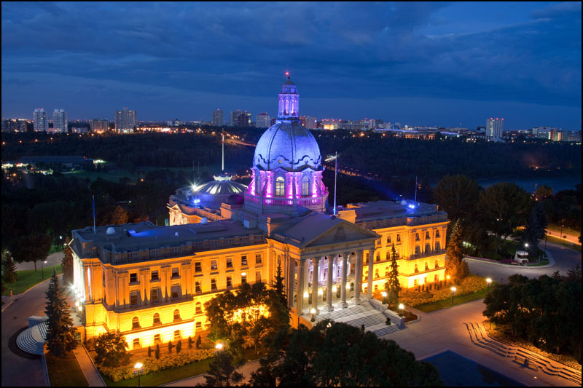
Notes:
School being presented to

Slide 3

Who Is CAUS?
CAUS is all business
Notes:
Update photo

Slide 4

Who Is CAUS?
…most of the time
Notes:
Update photo

Slide 5

What CAUS Is
Represents over 100,000 undergrads to the government, public and stakeholders
Five members:
SA MacEwan University SA Mount Royal University University of Alberta SU
University of Calgary SU
University of Lethbridge SU

Slide 6
Mission & Vision
Mission: To ensure a high quality, affordable, and accessible post-secondary education for Alberta undergraduate students through strong researched based advocacy
Vision: University students are active contributors in developing a high quality post-secondary sector that is accessible and supportive to all students regardless of background or financial means

Slide 7
History
Created in 1986 to facilitate information sharing
Through 1980/90s fighting wave of funding cuts
Major election campaigns throughout CAUS history
Key stakeholder and influential voice in AB PSE
Founded on principle of unanimous agreement
Small in number, but great in influence
MacEwan + Mount Royal SAs joined in 2014/15
Notes:
Started with 4 CARIs. First staff person in the early 90s. Consensus based organization guided by the friendship model of governance.

Slide 8
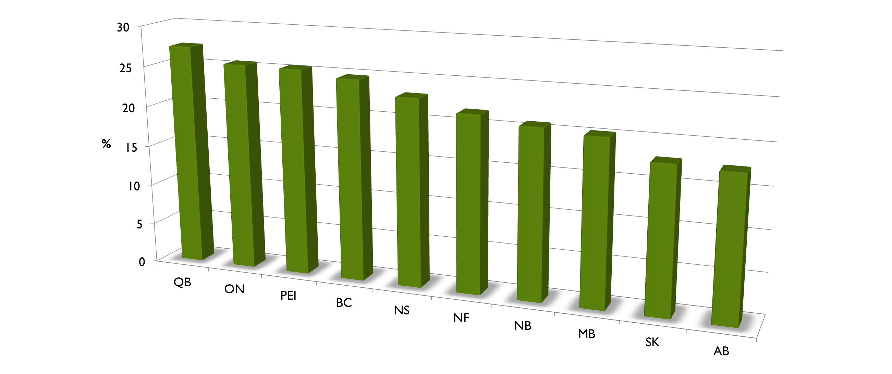
What Has Happened
2013 PSE Participation, 18-35 Year Olds
Notes:
Last data we have from the Campus Alberta Planning Resource → AB 18%

Slide 9
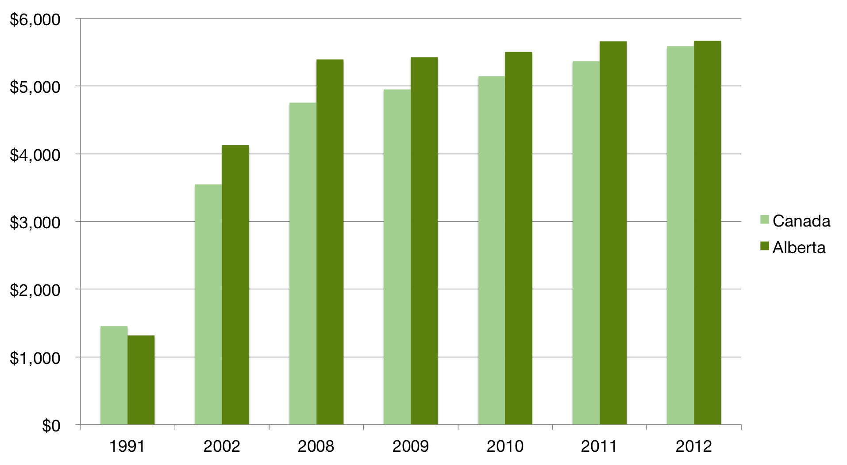
What Has Happened
Average Tuition in Canada as Compared to Alberta (indexed to inflation)
Notes:
Needs to be updated – point of the slide is to show dramatic rise in tuition from 1991

Slide 10
How CAUS Works
Students
Members
(Execs, Councils, Students’ Unions)
CAUS
Executive Director
Chair &
Vice-Chair
Staff
Members
Notes:
Presidents VPX are participating members of CAUS – One school, one vote – primary delegate and vote are VPX – as members of council you can always ask your execs or get in touch with home office

Slide 11
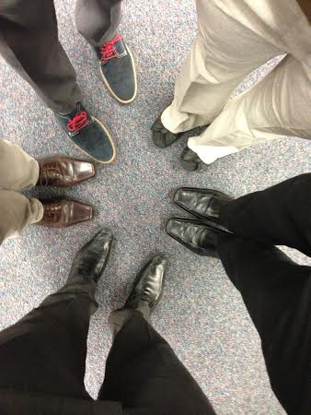
How CAUS Works
2 representatives per school
Executive Director
Research & Policy Analyst
Meet in person every ~6 weeks
Teleconferences as needed
Operate on consensus basis
$1.90 per FLE
Notes:
Fees – Oct/Mar – How much does each school pay? What percentage? U of C – $39 273 or 27% of total budget
Alternate meeting locations – Edmonton, Calgary, Lethbridge
Discuss the RPA position

Slide 12
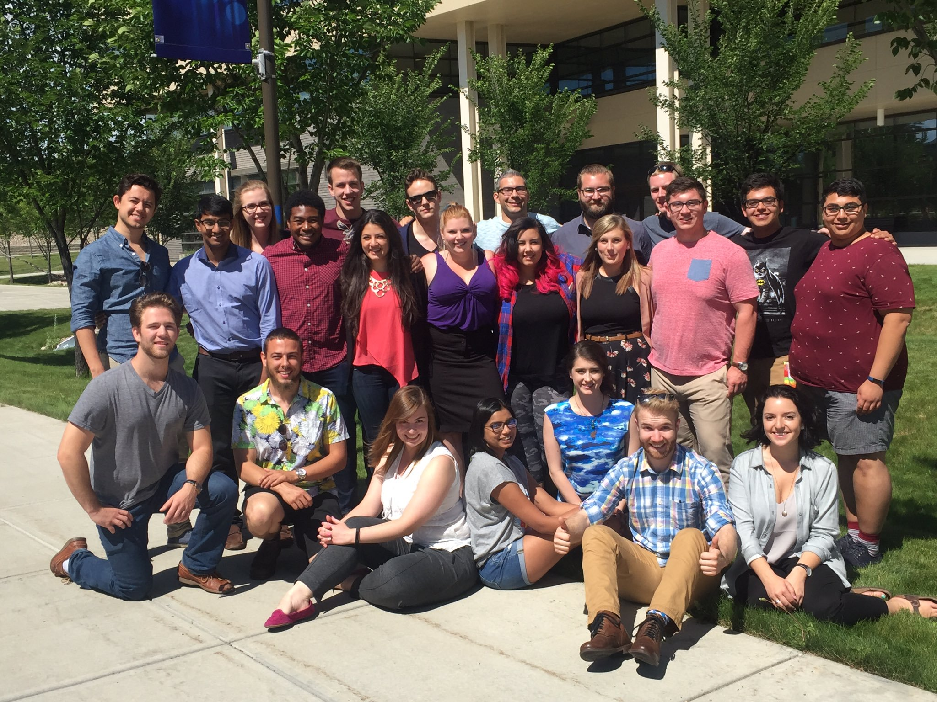
What CAUS Does
Advocacy Week(s)
Changeover
All-Exec
Satellite Advocacy
Policy Updates
Document Development
Basecamp Work

Slide 13
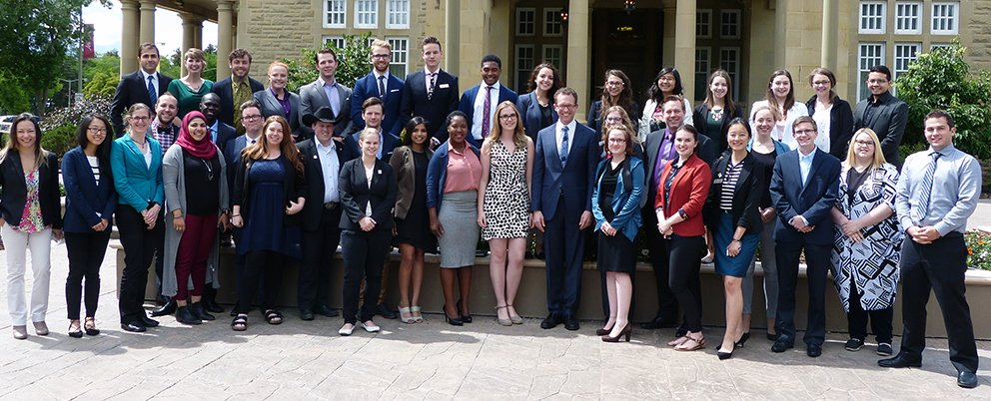
Partners in PSE
Other Student Groups
  ASEC
  AB-GPAC
  CASA
Stakeholder Groups
  PIA
  ASAPA
  CAFA

Slide 14

What CAUS Has Done
Elections Act Changes
GOTV Campaign
Party Platforms
Student Aid Changes
Tuition Freeze + CPI Cap
IGNITE Alberta
Notes:
Election Act change – 2012
GOTV campaigns 2012/2015
Influence on party platforms re PSE – worked with all parties. Some parties approach us more for assistance.
Student aid changes – removing the vehicle deduction, parental/spousal contributions, part time earnings – now flat 1500$ contribution
2014 Tuition Freeze – NDP Tution freeze
IGNITE – CAUS led conference with ASEC/AbGPAC – partnered with admin and sponsored – what do student want to see for their future? – student survey

Slide 15
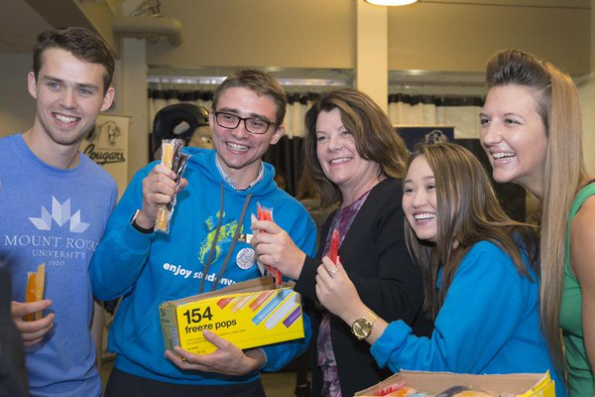
What CAUS Has Done
Tuition Freeze
MNIF Freeze
Market Modifier Rollback
STEP
Notes:
NPD election – Tuition/MNIF freeze, Reimplementation of STEP, MM Rollback

Slide 16
Tuition Review
2015 the Government of Alberta announced their Adult Learning Review
2017 Tuition Freeze was announced in November 2016 along with a tuition review consultation
Part one of the consultation is ongoing through http://tuitionreview.alberta.ca/ - Survey and stakeholder submissions
Part two is a working group beginning in January 2017
Notes:
Delete slide – replace with Tuition review – put link for survey – there will be working group with student reps – look forward to more updates from VPXs and presidents

Slide 17
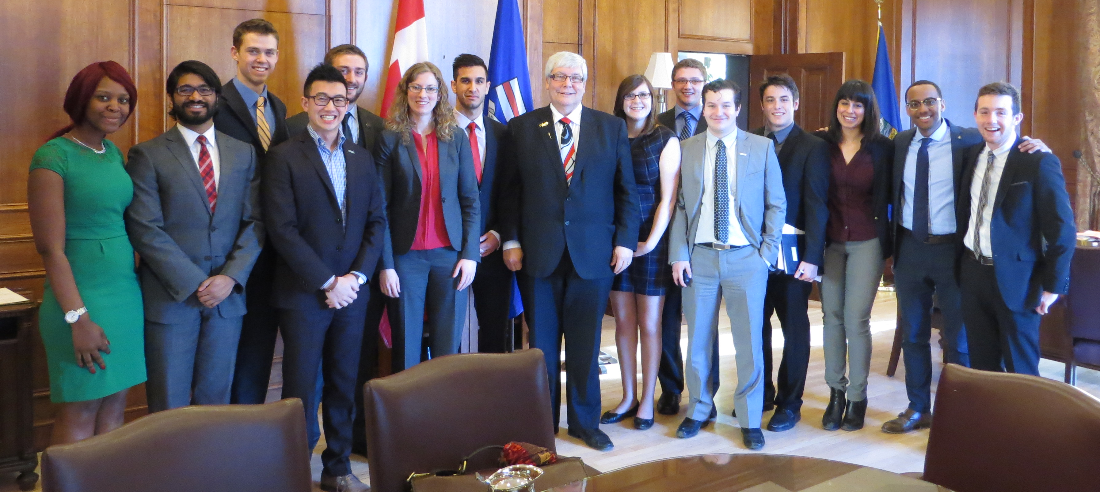
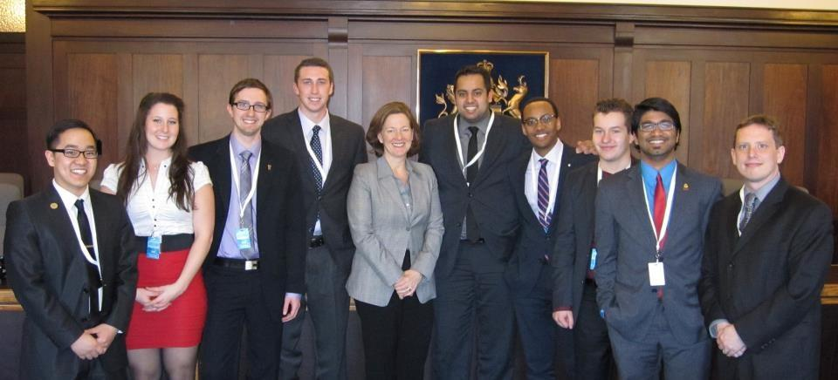
Meetings with Premier Hancock &
Premier Redford

Slide 18

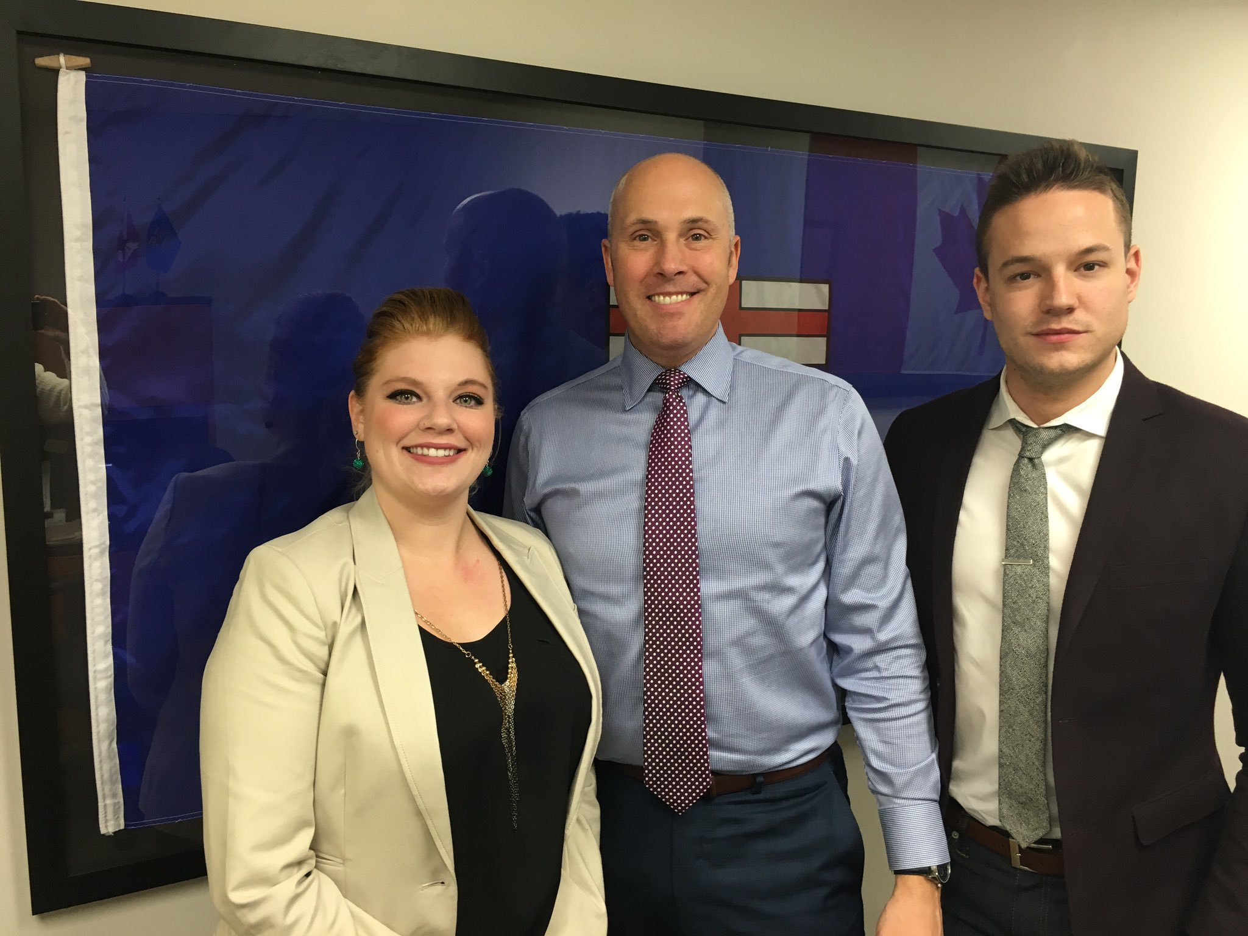
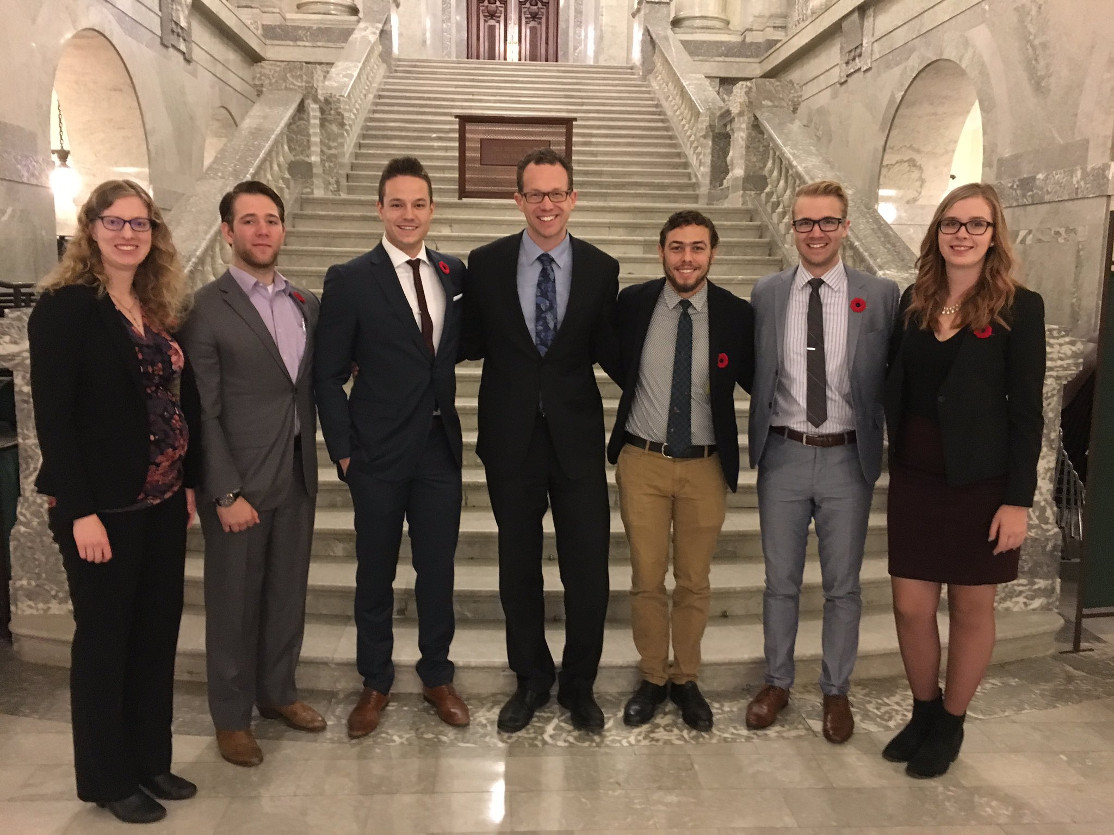
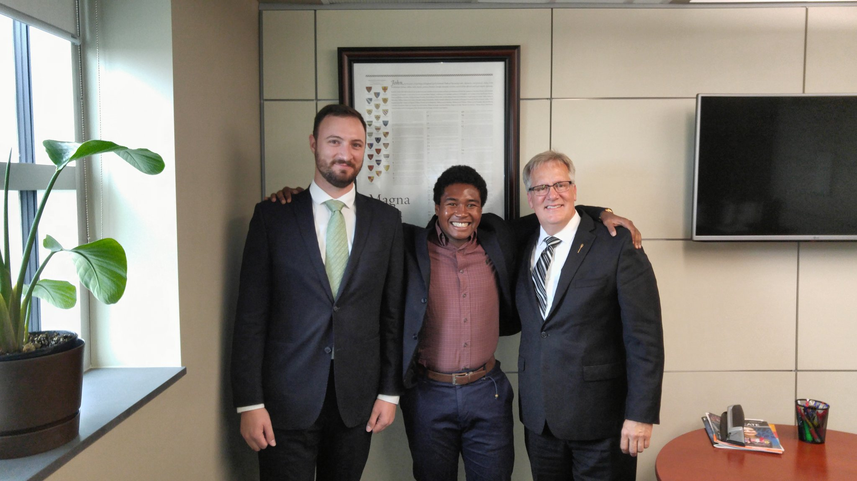
New Government – New Minister – New MLAs
Notes:
Switch this with slide before

Slide 19
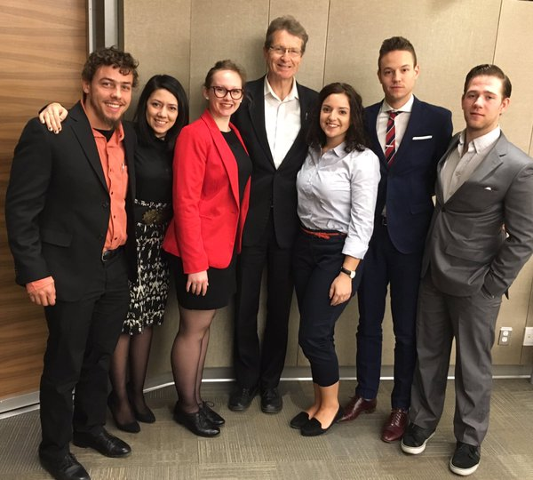
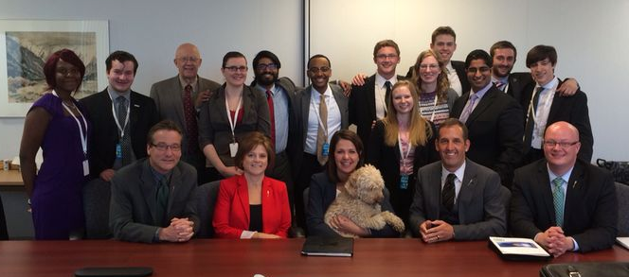
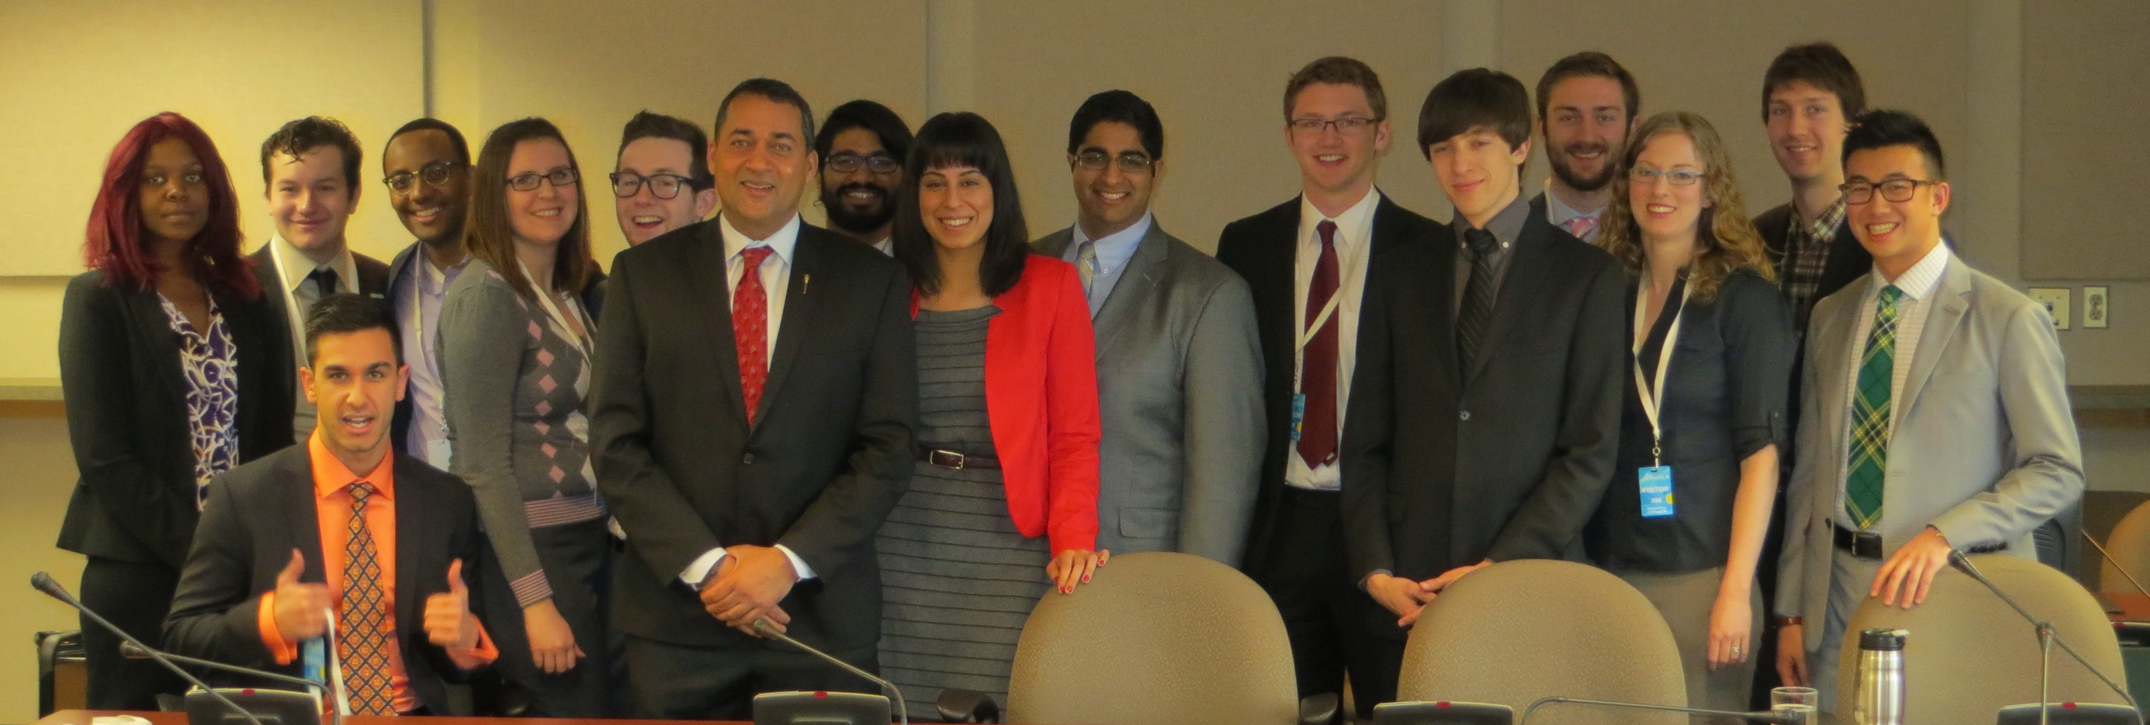
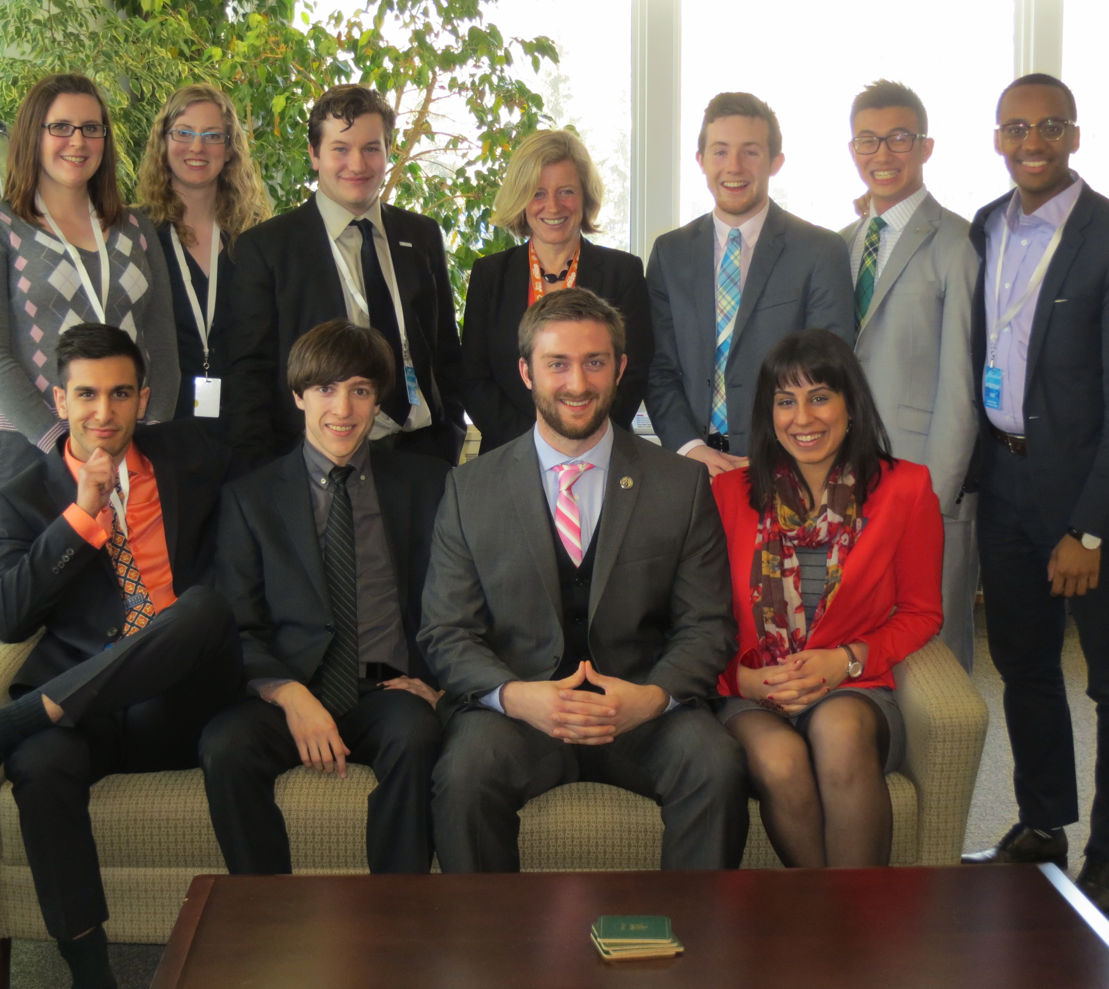
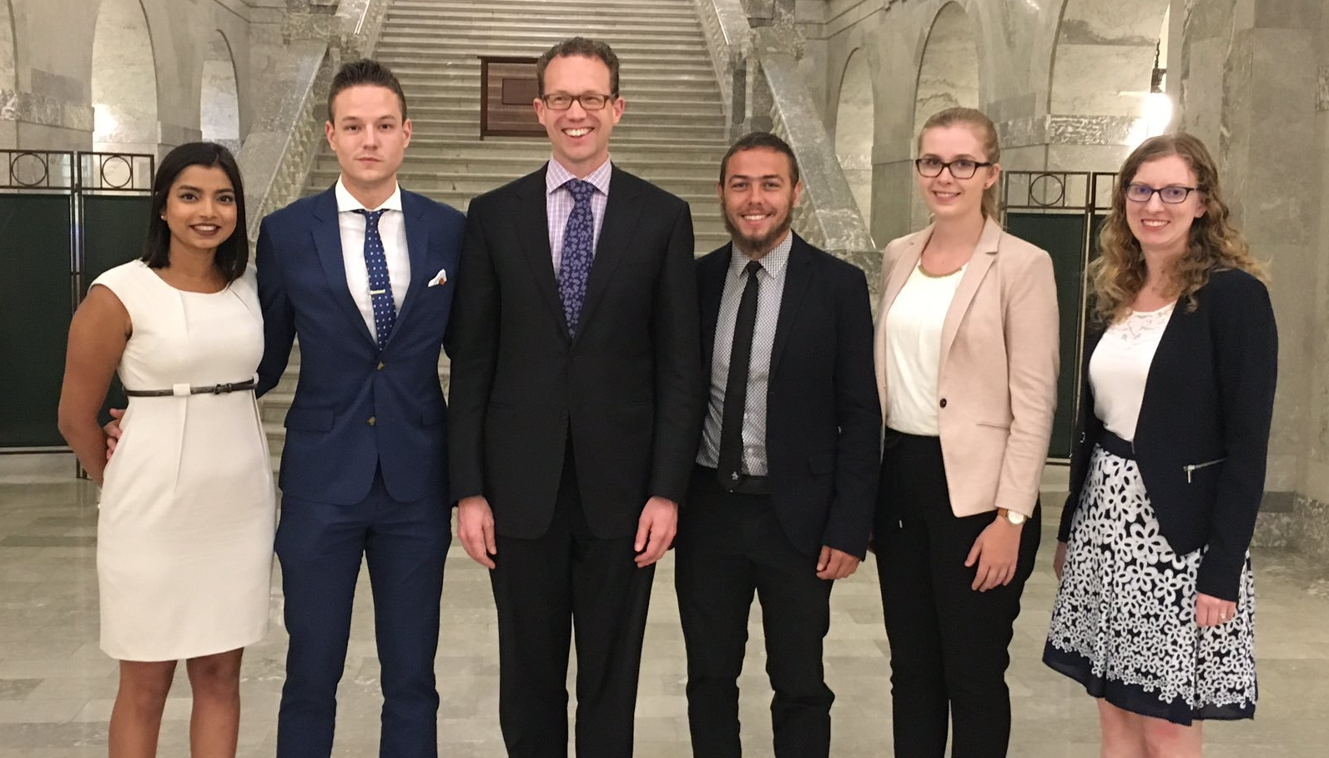
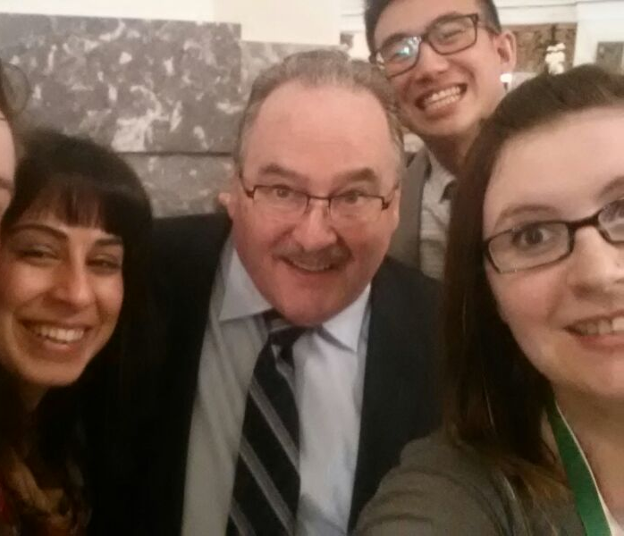
Meetings, Meetings, Meetings, Meetings, Meetings, Meetings
Notes:
70 meetings in 2012/13
Over 90 meetings in 2013/14
2014/15 – strange year for trying to get meetings!
15/16 – very different meetings as the MLAs are all very new to the full range of topics that they encounter as MLAs.
16/16 – meetings have become more holistic and available as MLAs become more comfortable in their roles – CAUS and its respective SU/SAs meet regularly with MLAs from all parties.

Slide 20
Priorities
Adult Learning Review
  Tuition
  Market Modifiers
  Mandatory Non-Instructional Fees (MNIFs)
  Student Financial Aid
  Governance
Mental Health
Student Employment
Notes:
Update these

Slide 21
Questions?
Ask right now!
Ask later!
        Dexter Bruneau, Chair
        vpexternal@samru.ca / 403-440-6404 / @SAMRUVPExternal
        Carley Casebeer, Vice Chair savpexternal@macewan.ca / 780-633-3763 / @carleycasebeer
        Joshua McKeown, Interim Executive Director
        josh@caus.net / 780-297-4531 / @joshuanmckeown
        http://www.caus.net / @CAUS
Notes:
Update info

